Slide 1



SunGuide Operator Training
Release 7.0
Dates of Training, 2017

Slide 2
Agenda
Part 1: Introduction
  SunGuide Operator Training
  SunGuide Overview
  Operator Map
Part 2: Traveler Messages
  Dynamic Message Signs (DMS)
  Highway Advisory Radio (HAR)
  Beacons
Part 3: Cameras and Video
  Closed Circuit Television (CCTV)
  Scheduled Actions Subsystem (SAS)
  Video Switching and Control
Part 4: Roadway Monitoring
  Roadway Weather Information Systems (RWIS)
  Transportation Sensor Subsystem (TSS)
  Connected Vehicle (CVS)
  AVI / LPR Traffic Sensors
  Travel Times (TvT)
  Safety Barrier (SB)
Part 5: Event Management (EM)
  Events and Event Details
  Response Plan Generation (RPG)
  Event Viewer
  Event Management Auditing
  Incident Detection Subsystem (IDS)
  511 Floodgates
  Road Ranger Management
  Smart Phone Application for Road Rangers (SPARR)
Part 6: Reporting
  Reporting Subsystem
  Regional Integrated Transportation Information System (RITIS)
Part 7: Additional Traffic Management
  Inventory and Maintenance Subsystem (IMS)
  Express Lanes Management
  Toll Viewer
  Managed Lanes
  Traffic Control
  Truck Parking
  Ramp Metering

Slide 3
Part 1: Introduction

Slide 4
SunGuide Operator Training

Slide 5
Purpose of Operator Training
Initial exposure to SunGuide software, concepts, and latest changes/enhancements
Training should continue in “live” operational environment
Explains how to use the software
  Operational procedures differ from district to district
  Operators should follow district-specific procedures

Slide 6
Training Format
Step through concepts and windows on a section by section basis
After each section, operators will have “hands on” time to familiarize current portion of the software
Feel free to ask questions any time
  Deviating from the course material is welcomed

Slide 7
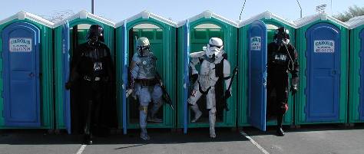
House Keeping
Please sign in and PRINT clearly
Breaks built into training

Slide 8
SunGuide Overview

Slide 9
SunGuide Architecture
FDOT District X
Road Ranger Tablet/ SPARR
Devices
(DMS, CCTV, AVL, AVI, etc…)
3rd Party Traffic Data
(NOKIA, HERE, BlueTOAD, etc.)
SunGuide Software
RTMC Operators
SunGuide
Database
SunGuide C2C
FDOT District Y
FDOT District Z
SunGuide C2C
FL ATIS (511)
SunGuide C2C
C2C
SunGuide
DB
FL ATIS
SunGuide
DB
511
Website

Slide 10
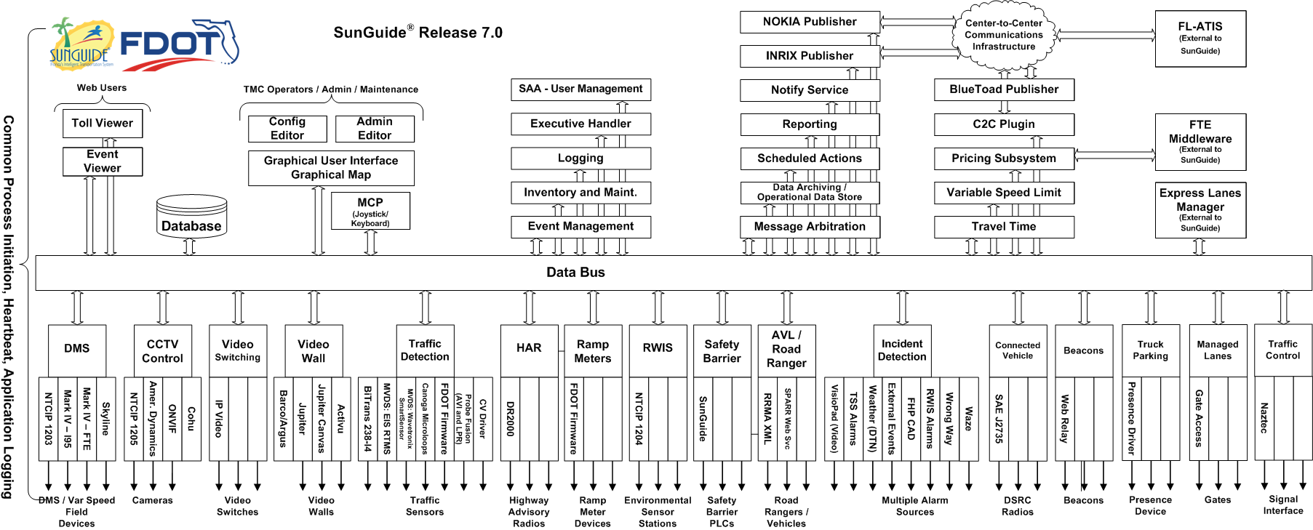
SunGuide Software Architecture

Slide 11
What’s New?
R7.0
  Several new dialogs to replace Admin Editor functionality
  Traffic Control Subsystem
  Truck Parking Subsystem

Slide 12
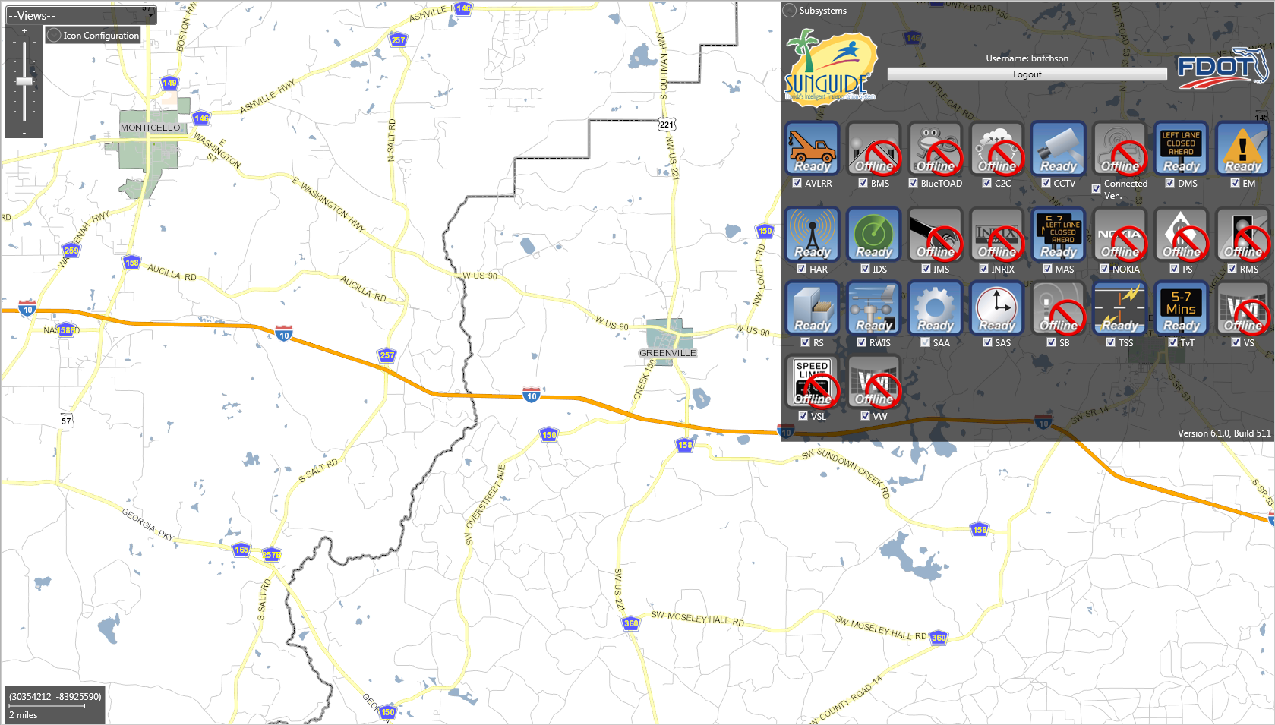
Operator Map

Slide 13
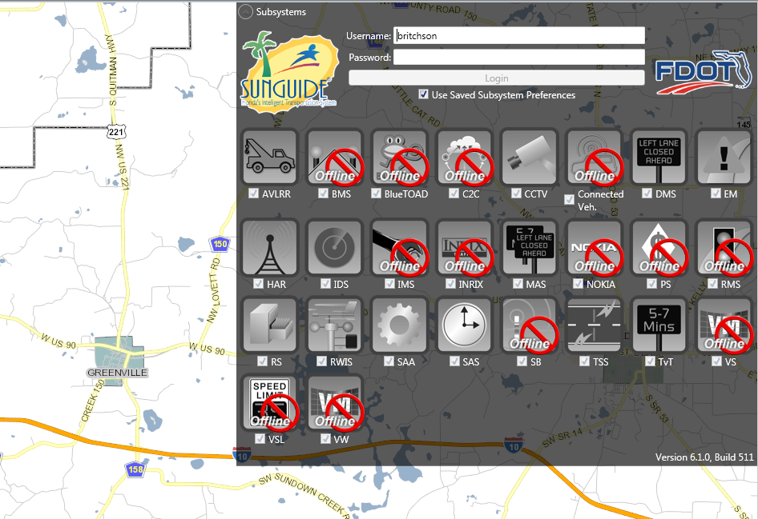
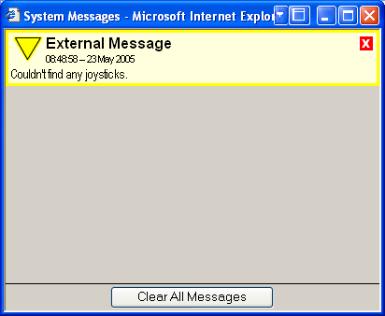
Logging In
Username and Password
  Both are Case Sensitive
  Administrator creates/edits user accounts (via the Admin Editor)
Subsystem Loading Progress Displayed
Watch System Messages for Extra Information

Slide 14
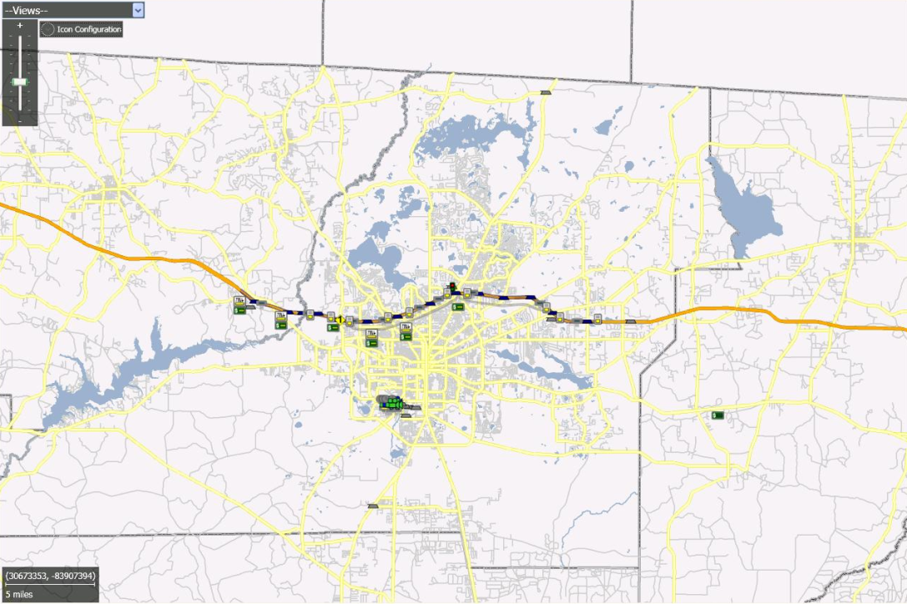
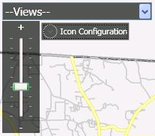
Map: Managing Your View
Zooming:
  Zoom buttons in Navigation Panel
Panning:
  Click and drag map
Jump to Views:
  Cities
  Districts
  Areas of Interest
  Drop down box in panel
Zooming

Slide 15
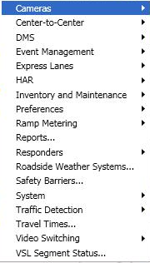

Map: General Concepts
Main Context Menu
  Right click on background of map
Common functionality for each subsystem
Device Status
  Active: Operating normally
  Error: Communication or other problem, will be polled normally
  Failed: Several consecutive errors, will no longer be polled normally
  Out of Service: Manually disabled
  Device icons typically colored based on status
Device / Event Icons
  Left click: Status
  Right click: Context menu for item

Slide 16
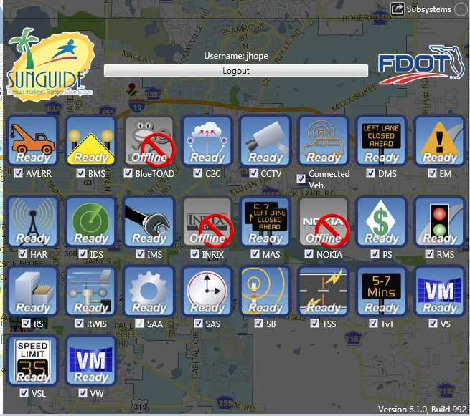
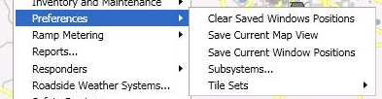
Map: Preferences
Preferences Menu
  Save Current Map View
    Re-centers zoomable area
    of map
  Save Current Window Positions
    Windows will reopen to current position
    General windows will reopen on login
  Subsystems
    Opens the window listing the subsystems that the user is logged into
  Tile Sets
    Allows user to change the “tiles” used to draw the map

Slide 17

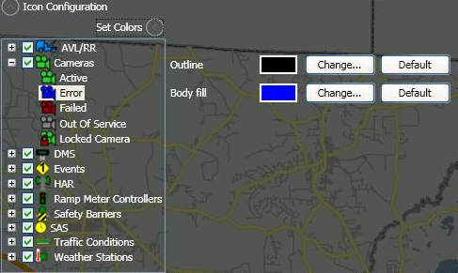
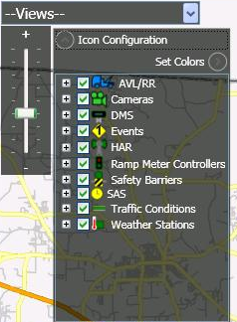
Map: Icon Configuration
Icon Configuration is found at the top left corner of the map
Selected icons are displayed on the map
The color of icon states can be altered
Displayed on map if checked

Slide 18

System Settings
Configuration

Slide 19
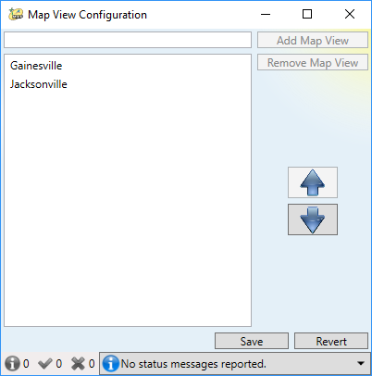
Map View Configuration
Zoom and pan to specific areas of the map
Save map view
Views are accessible from all users

Slide 20
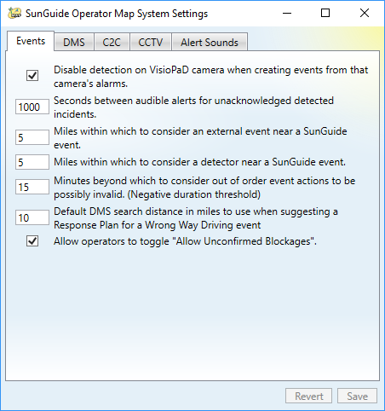
System Configuration
Category-based configuration settings
Globally defined

Slide 21
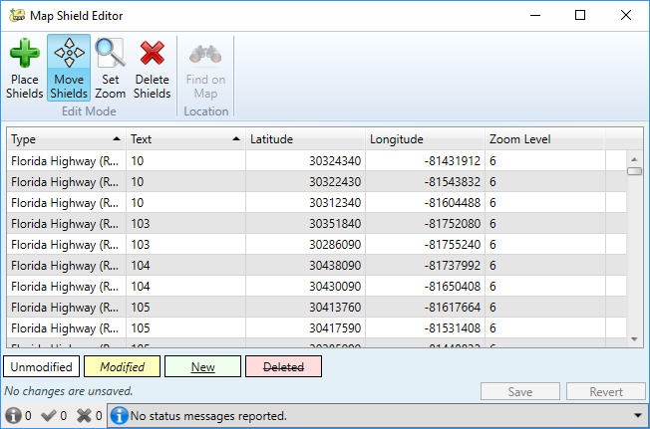
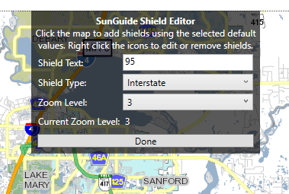
Map Shield Editor
Create and place shields on map

Slide 22
Operator Map
Hands on
15 Minutes

Slide 23
Part 2: Traveler Messages

Slide 24

Dynamic Message Signs (DMS)

Slide 25
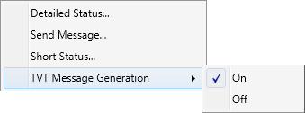
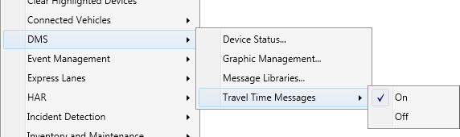
DMS: Menu Options
DMS Device Context Menu
(right-click on local DMS device)
DMS Context Menu
(right-click on Operator Map)
Notes:
Note that “Remote” DMS refers to other districts’ DMS. May not be applicable if C2C not configured for this.
Demo: DMS Menu:
Show the menu options for DMS

Slide 26
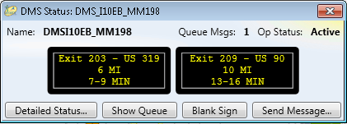
DMS: Short Status
DMS Short Status Window
  DMS Device Context Menu
    Short Status
  Includes…
    Name
    Number of Messages in Queue
    Operational Status
    Few buttons for control

Slide 27
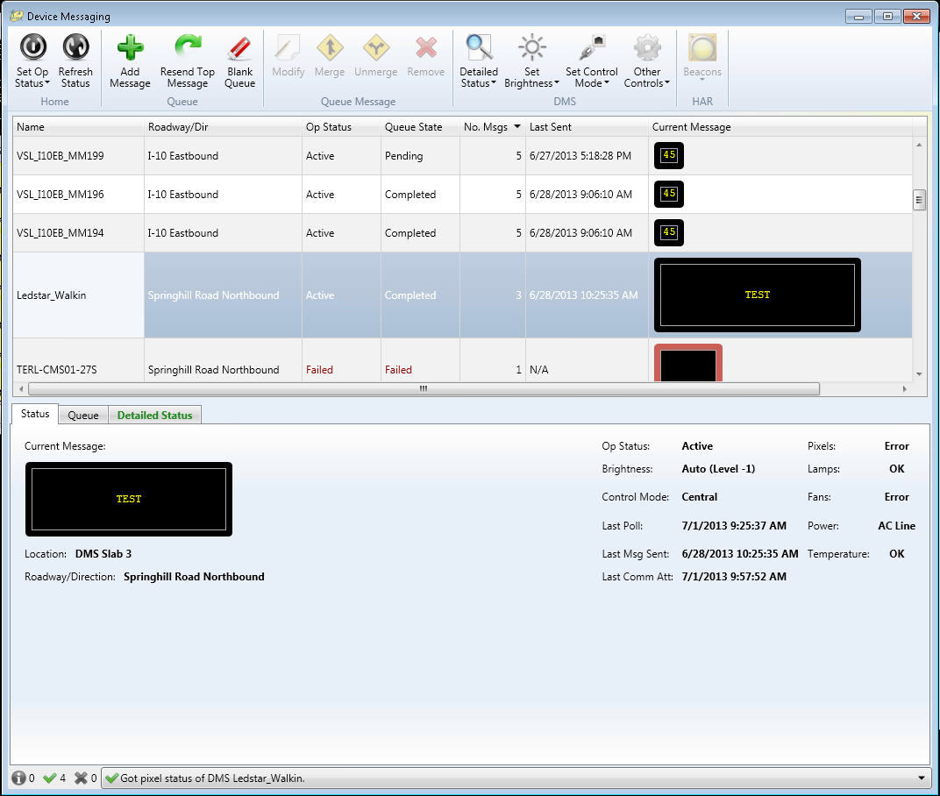
DMS: Device List
Device list displays important information in tabular form in-line with device names
Rows can be sorted and filtered by column
Actions can be performed on multiple items by using Shift or Ctrl to select multiple DMSs

Slide 28
DMS: Full Status
Full status
  From DMS Device Context Menu
  Or, from DMS Context Menu
  Or, from DMS Status Window and select “Detailed Status”
Full status is displayed in the “Status” tab
Notes:
Need subject and verb (missing verb) hard to tell what is being presented from bullets

Slide 29
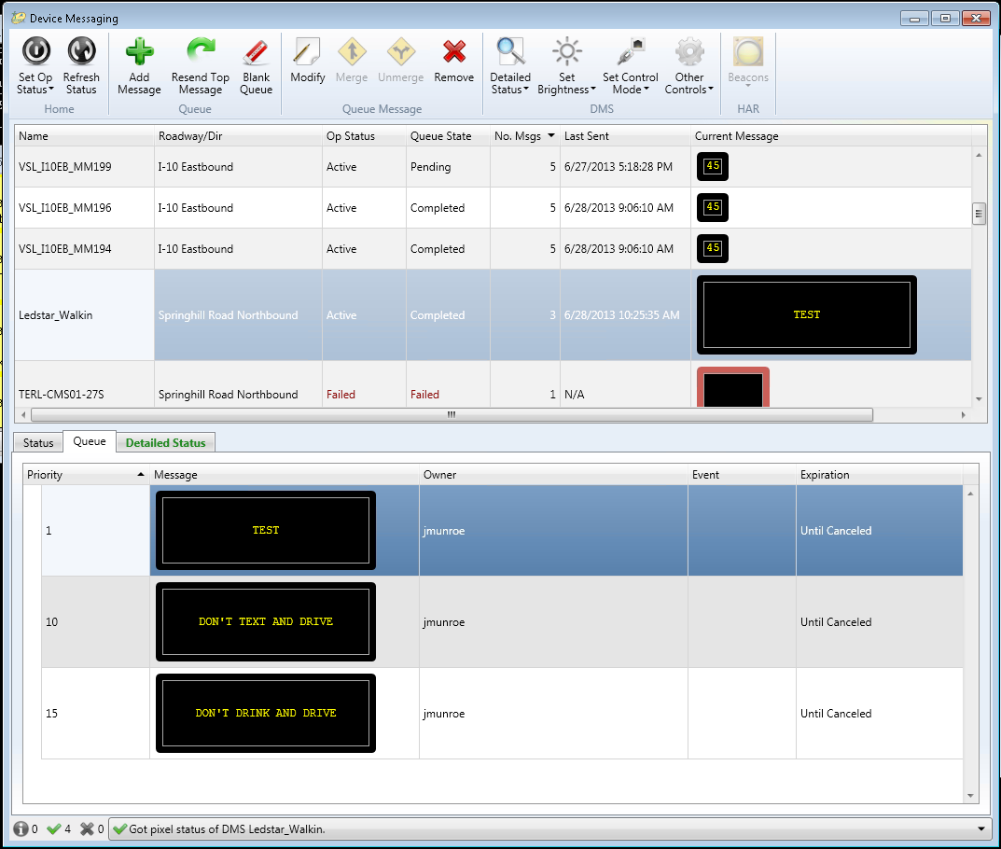
DMS: Message Queue
Message Queue
  Select “View Queue” from the Short Status
  Or, Select a DMS device from the Device Messaging Window and click on the “Queue” tab
Shows list of messages currently queued

Slide 30
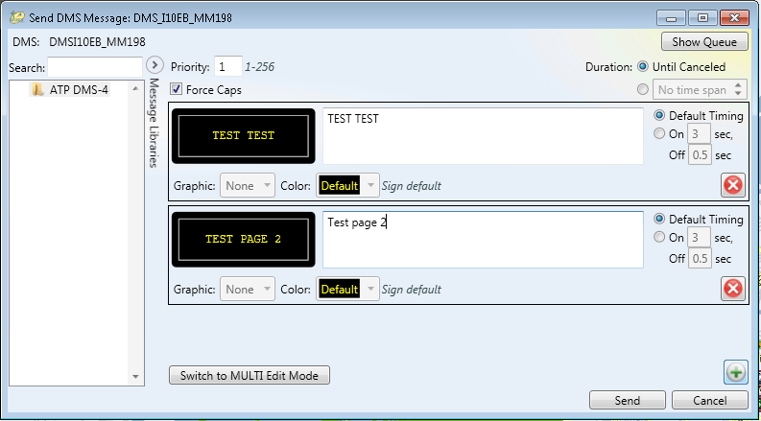
DMS: Send Message
Send message
  From Short Status Window
  Or, from “Add Message” button within the Device Messaging Window
Ability to create messages with:
  Multiple pages
  Graphics
  Custom Colors
Notes:
Maybe point to controls for the list of items

Slide 31
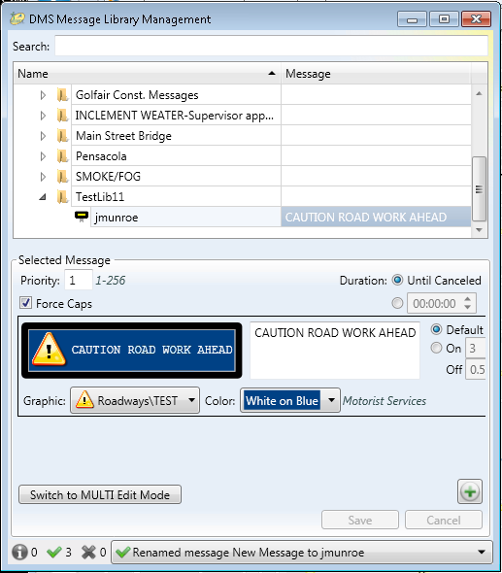
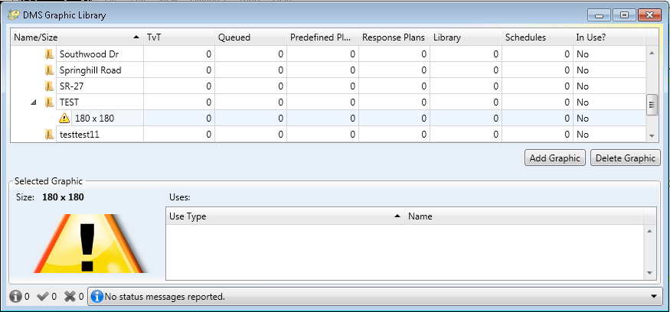
DMS: Message & Graphic Library Management
Manage Libraries from the Operator Map DMS Context Menu
  Graphic Management
  Message Libraries
Add/Modify/Delete items

Slide 32
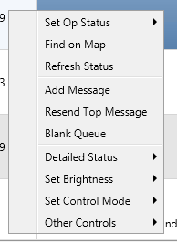
DMS: Device Messaging Window Menus
Use the top menu within Device Messaging Window to control DMS Devices
DMS Devices can also be controlled by right-clicking the device within the Device messaging Window to bring up a Device-specific menu
  Select multiple DMS with Shift or Ctrl

Slide 33
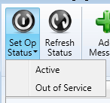
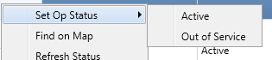
DMS: Device Messaging Window: Set Op Status
Set a DMS device’s operational status to:
  Active
  Out of Service
Select the device within the Device Messaging Window
Set the Status by:
  Click the “Set Op Status” button from the top menu
  Or, by navigate to “Set Op Status” within the
  Device-Specific
  menu

Slide 34
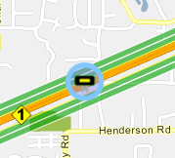
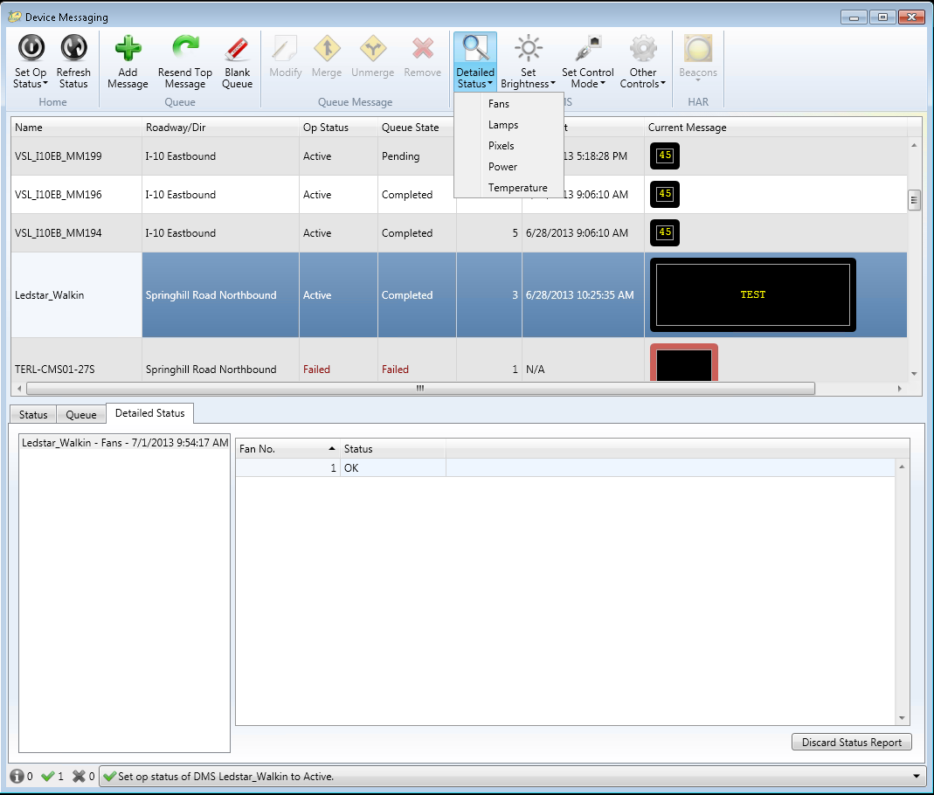
DMS: Device Messaging Window: Refresh Status & Find on Map
Find on Map
  Select to circle device on Operator Map
  This option can only be found in the Device-Specific Menu
Refresh Status
  Refresh a DMS device’s status by selecting “Refresh Status”

Slide 35
DMS: Device Messaging Window: Queue
Add Message
  Causes the Send Message Window to pop-up
  New message will be added to queue
Resend Top Message
  Sends the top message in the queue to the device
Blank Queue
  Removes all of the messages from the queue
  Removes the currently displaying message from the device

Slide 36
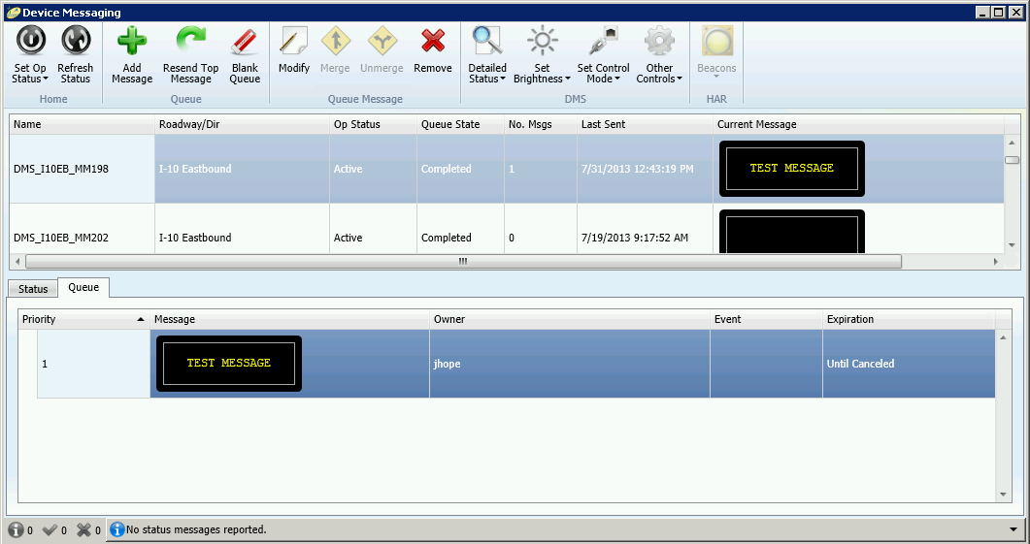
DMS: Device Messaging Window: Queue
Message queue lists all messages sent from SunGuide to a DMS in priority order
  1 = highest priority, 255 = lowest priority
  Note: “Completed” queue state for successfully sent messages

Slide 37
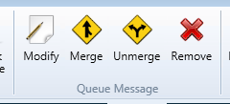
DMS: Device Messaging Window: Queue Messaging
Modify
  Brings up Edit DMS Message Window
  Very similar to Send Message
Merge
  Select multiple messages in Queue and click “Merge” to group messages
Unmerge
  Disassociates grouped messages
Remove
  Deletes selected message from Queue

Slide 38
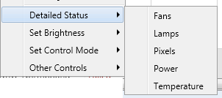
DMS: Device Messaging Window: Detailed Status
Retrieves Status of various DMS components
To select a component to view:
  Click the Detailed Status Button
  Or, Select Detailed Status from the Device-Specific menu
View the returned status of the chosen component(s) in the “Detailed Status” tab

Slide 39
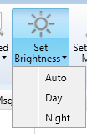
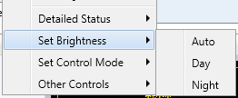
DMS: Device Messaging Window: Set Brightness
Set the Brightness for a DMS Device
Options for brightness level are:
  Auto, Day, and Night
To select the desired brightness for a DMS device
  Click the Set Brightness Button
  Or, Select Set Brightness from the Device-Specific menu

Slide 40
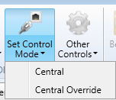
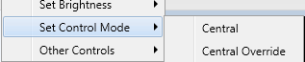
DMS: Device Messaging Window: Set Control Mode
Set the Control Mode for a DMS device to:
  Central
  Central Override
To set the Control Mode for a DMS device
  Click the Set Control Mode Button
  Or, Select Set Control Mode from the Device-Specific menu

Slide 41
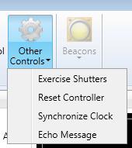
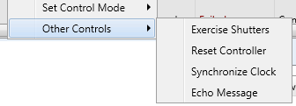
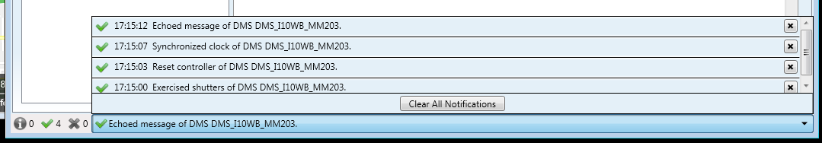
DMS: Device Messaging Window: Other Controls
To view the Other Controls options for a DMS device
  Click the Other Controls Button
  Or, Select Other Controls from the Device-Specific menu
After selecting an option from the
menu, the bottom bar will post
a notification concerning the
success of the operation
  A dropdown will show more notices

Slide 42
Dynamic Message Signs (DMS)
Configuration

Slide 43
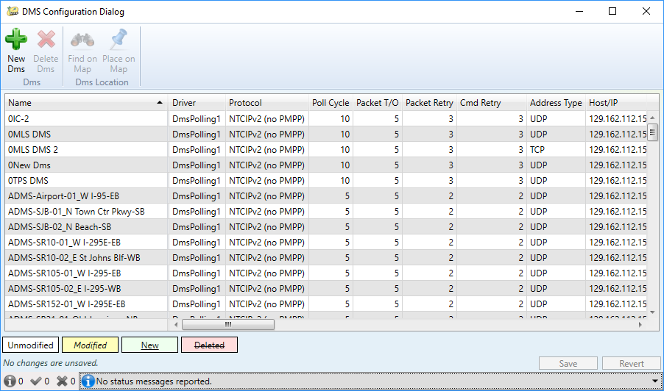
DMS: Configuration
Sign Configuration
Lists all DMS, attributes, and connection info
  Sort upon column click
  Click “Save” after adding and/or editing one or more
Confirm successful save with Green Check

Slide 44
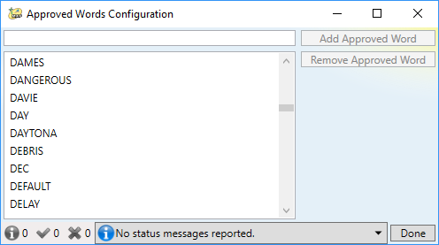
DMS: Configuration
Approved Words
Lists words alphabetically
  Case-insensitive

Slide 45
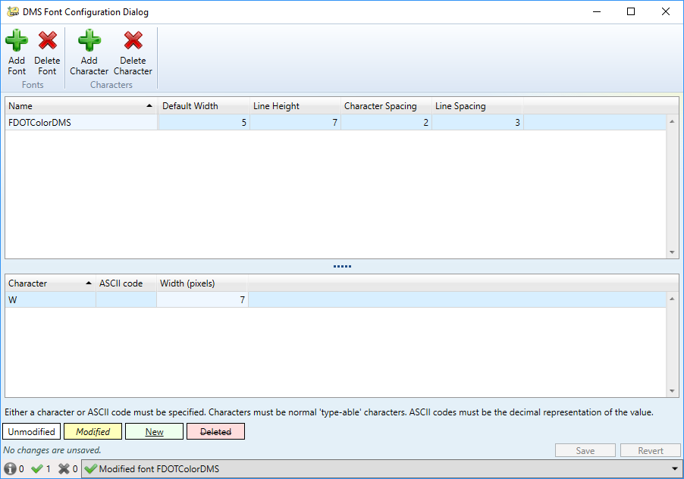
DMS: Configuration
Font Configuration
Specify font with height, spacing, and default width
  Optional characters with non-default widths

Slide 46
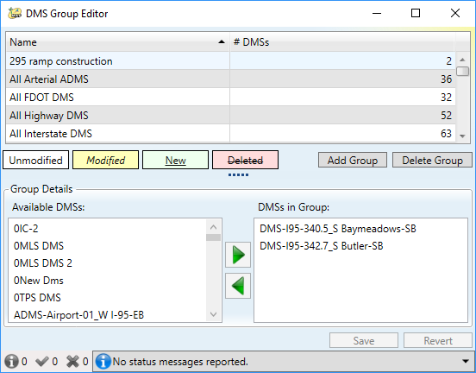
DMS: Configuration
DMS Group Editor
DMS grouping
  Used to filter DMS by groups

Slide 47
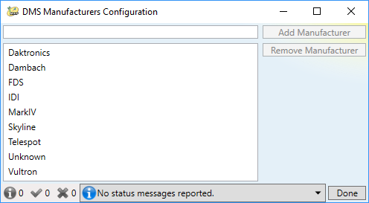
DMS: Configuration
DMS Manufactures
Listing of Sign Manufactures
  Listed in alphabetical order

Slide 48
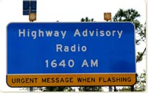
Highway Advisory Radio (HAR)

Slide 49



How does HAR work?
SunGuide Operator
Text Event Report
Text-to-Speech via the Radio
SunGuide operator creates and sends selected HAR event information
  By selecting HAR
  By generating a Response Plan
Activated HAR translates text information to voice audio file and report over the radio
Drivers hear traffic report on the radio

Slide 50
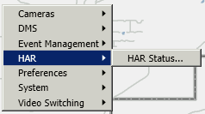

HAR: Context Menus
Main HAR Context Menu
Device Icon Context Menu

Slide 51
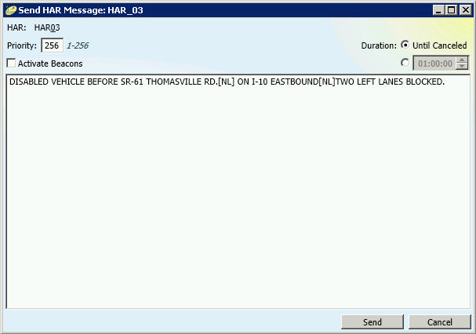
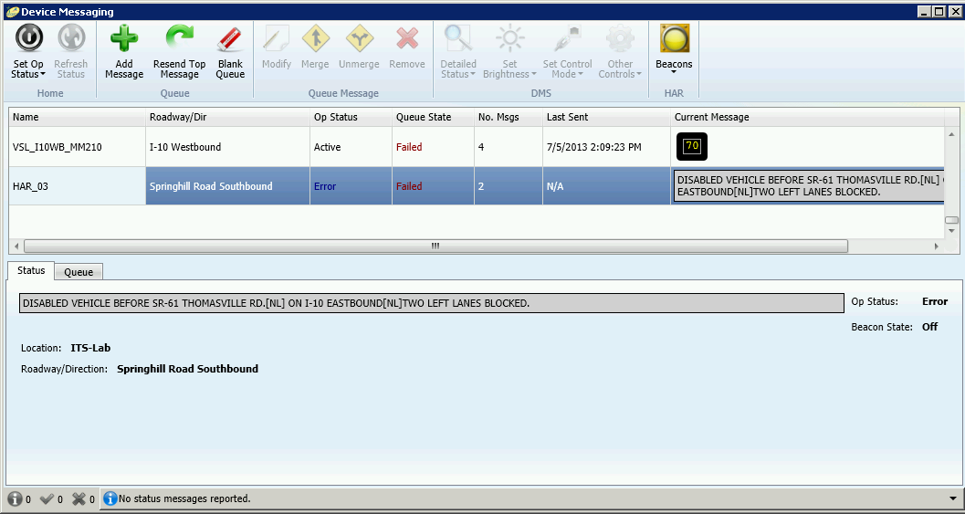
HAR: Messaging
Uses the same Device Messaging window used for DMS
  Send HAR Message window differs
Notes:
Similar to DMS status window.
- Lists all HAR stations in list in upper left hand corner
List of HAR can be filtered
Can activate/deactivate beacons
Stop message
Click “Send Message” to send new message or override the current message

Slide 52
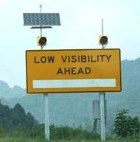
Beacons

Slide 53
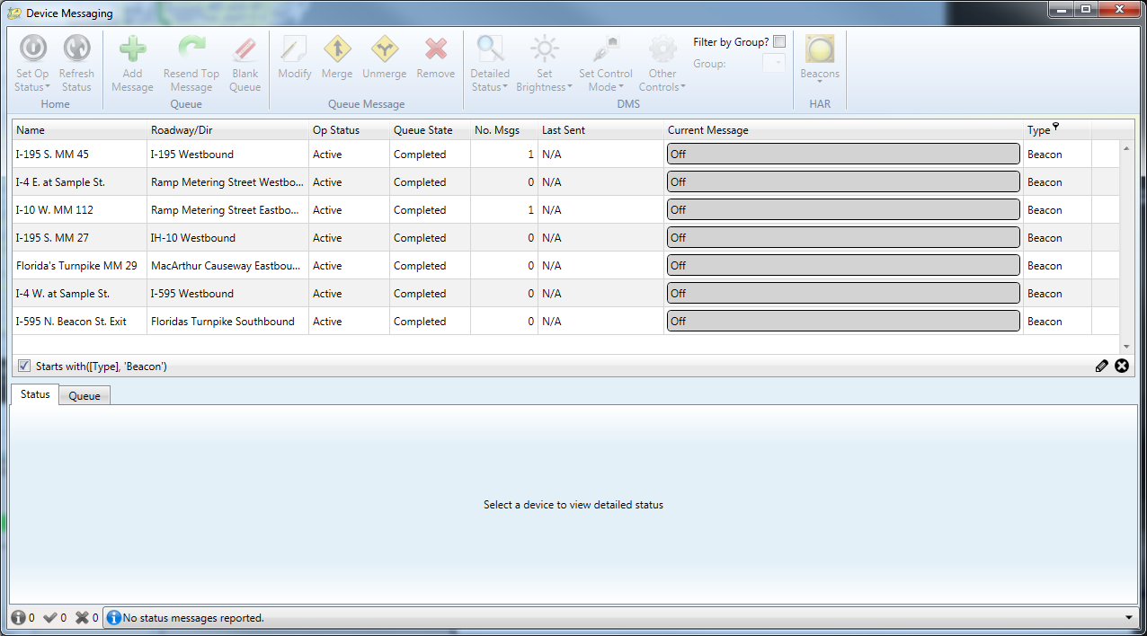
Beacons

Slide 54
Beacons
Configuration

Slide 55

Beacons: Configuration
Specify sign type, connectivity, and location

Slide 56
DMS and HAR
Hands on
20 Minutes

Slide 57
Part 3: Cameras and Video

Slide 58

Closed Circuit Television (CCTV)

Slide 59

CCTV: Camera Control
Control Camera
  Pan
  Tilt
  Nudge
  Zoom
  Focus
  Iris
Lock:
  Release
  Override
Presets:
  Save
  Recall
Selected Camera May Be Controlled By USB Joystick
Notes:
Local refers to cameras that are integrated with the local TMC’s SunGuide system
Locking refers to the system only allowing one user, either a person or process, to control the camera at a time. Typically, this is an automatic feature whereby a lock is acquired or overridden automatically whenever a PTZ command is issued by any operator or by the joystick; however, advanced configurations can be setup that restrict the override and thus the release lock feature is necessary for other users without the override permission to acquire the lock (without having to override it from another user)
If camera is locked by moving a camera (i.e. issuing a PTZ command), the camera will automatically unlock if the camera is not moved for a configurable amount of time. Manually locking by clicking “Lock” will lock the camera permanently until unlocked.
Cameras list (upper left hand corner of window) will allow operators to select different cameras.
Demo: CCTV Camera Control
Show the ptz, nudge, presets, and locking features
Save a preset and jump to the preset

Slide 60


CCTV: Advanced Camera Functions
Camera Menus
  Select display time
  Up, Down, Left, Right buttons navigate
  Enter to select
  Some cameras use page and value buttons, some do not
Detailed Data
  Select data type
  Select additional parameters, if necessary
  Press Get Details
  Response will be displayed in a new window
Notes:
These features are not normally used as the standard camera control dialog is adequate

Slide 61
CCTV: Video on Desktop (VoD)
Integrated into Operator map
  Double-click, drag-and-drop
Full-featured and detailed for usability
  User saves/loads VWW viewer positions (and tours)
  PTZ control and preset buttons in viewer
  Full screen
    Virtual video wall in monitor
    Viewer in the virtual video wall
  Support for video tour “drag and drop-on-top”
    Tour configuration saved with virtual video wall layout

Slide 62


VoD: Menus
Main Video on Desktop (VoD) Menu
Camera Specific Context Menu

Slide 63

VoD: Definitions
Window can contain any number of viewers
Viewer can contain any number of camera streams /tours
Window
Viewers

Slide 64

VoD: Window and Viewer Creation
Windows are created through:
  Operator map context menus
  Top level VoD menu
Viewers can be created through:
  Operator map context menus
  Drag and drop of icons from OM
  Top level VoD menu

Slide 65


VoD: Viewer Manipulation
The position and size of viewers can be altered in the following ways:
  Resizing the window
  Drag and drop of viewers
  Or, Right-click on camera icon
    Select the Desktop Video Wall from the “Desktop Video Dialogs” submenu

Slide 66

VoD: Tour Creation and Editing
Dynamic tours can be created by dragging camera streams into the center of an existing tour or camera stream
Saved tours can be created through the VoD menu or by saving a dynamic tour.

Slide 67


VoD: Camera Controls
Lock Camera
Pan/Tilt
Right click
Zoom
Focus
Presets
Notes:
Video switching places a selected CCTV into a display
In tours, a single display cycles through multiple CCTV cameras. Allows operators cycle through multiple cameras on one display.
Demo: Switching Video
Switch an encoder to a decoder
Configure a tour and switch the tour to a decoder

Slide 68

VoD: Camera Controls
Expand List of Cameras
Drag and Drop Cameras from List

Slide 69



VoD: Window Menu Options
New
  Open a new Desktop View Wall window or video panel
Options
  Hide/Show Labels
  Stretch/Unstretch Video
  Play/Stop Video
Layouts
  Save/Load/Delete video layout
Tours
  Save/Delete/Use Video Tours
  Also, right-click on video to select/edit tour

Slide 70


CCTV: Camera Blocking
Click “Camera Blocking” from Cameras context menu
Page lists all cameras posting images to the public website
Images not appropriate for public consumption should be blocked
Click “Block” to block the image from the 511 (FL ATIS) website
Notes:
This does not affect the local SunGuide system and local video viewing capabilities. Image blocking is only for external systems. In the current design, this only blocks camera images from the FL ATIS website.
Demo: CCTV blocking
Show the CCTV Tabbed GUI and block video from FL-ATIS

Slide 71

CCTV: Camera Blocking
Set reminders for blocked cameras
Notes:
This does not affect the local SunGuide system and local video viewing capabilities. Image blocking is only for external systems. In the current design, this only blocks camera images from the FL ATIS website.
Demo: CCTV blocking
Show the CCTV Tabbed GUI and block video from FL-ATIS

Slide 72


Keyboard / USB Joystick
Joystick can be used for simple PTZ
Manual Control Panel (MCP)
Capabilities
  Control CCTV devices (pan, tilt, zoom, focus, iris)
  Switch video (monitors or video wall)
  Display tours
Device Naming
  Numeric prefix required for cameras, monitors, and video wall viewers (example: 101-CCTV1)
Notes:
Demo Prep: SunGuide system with video streams and decoders that are viewable and a configured AD keyboard
Demo: Demonstrate the various functions as presented on the slides

Slide 73
Closed Circuit Television (CCTV)
Configuration

Slide 74

CCTV: Camera Configuration
Configure PTZ connection control
  Configuration must match camera controller configuration
  One or more video streams per camera
Notes:
This does not affect the local SunGuide system and local video viewing capabilities. Image blocking is only for external systems. In the current design, this only blocks camera images from the FL ATIS website.
Demo: CCTV blocking
Show the CCTV Tabbed GUI and block video from FL-ATIS

Slide 75

CCTV: Camera Configuration
Define buttons on USB Joystick
Notes:
This does not affect the local SunGuide system and local video viewing capabilities. Image blocking is only for external systems. In the current design, this only blocks camera images from the FL ATIS website.
Demo: CCTV blocking
Show the CCTV Tabbed GUI and block video from FL-ATIS

Slide 76

Scheduled Actions Subsystem (SAS)

Slide 77


SAS: Definitions
What is a sequence?
  A series of CCTV positions / zoom levels / presets
  Example: A sequence is configured to have Preset 1 and Preset 3 only. Activating that sequence would make a camera go to Preset 1, then Preset 3, then Preset 1, then Preset 3, etc…
What is a schedule?
  When activated, it starts and stops a sequence for a configured camera/cameras at a specified times
A sequence defines the actions to take while a schedule defines the times the sequence is activated

Slide 78


Accessing the SAS GUI
From the operator map menu, select “Scheduled Actions…” to bring up the SAS GUI

Slide 79


SAS GUI Menus
SAS Main Menu: Located at the top of the GUI
Schedule-Specific Menu
  Right-click on a Schedule within the Schedule box, or within the box itself

Slide 80
Add a New Schedule
There are two ways to add a new schedule
  Click the “Add New Schedule” button located in the SAS Main Menu
  Select “Add New Schedule” from the Schedule-Specific Menu

Slide 81


Add a New Schedule, cont’d
Once the option to add a new schedule has been selected, a new schedule will appear in the “Schedules” box within the SAS GUI
The new schedule can be renamed by single-clicking the name of the schedule, tying the new name, and pressing Enter.

Slide 82


Add a New Item to a Schedule
Highlight the desired schedule within the “Schedules” box by clicking on the schedule.
To Add New Item
  Click the “Add New Item…” button in the main menu
  Or, select “Add New Item to Schedule” from the Schedule-Specific menu

Slide 83

Add New Item: Scheduling
Within the “Add Scheduled Items” window
  Name of the Item may be changed
Within the “Scheduling” Tab
  Time/length of the event
  Recurrence pattern and frequency

Slide 84


Add New Item: Devices
Specify devices to be used for an action
  Select action type
Once Action Type selected, window will be populated with associated devices
  Use checkboxes to select devices

Slide 85


Add New Item: Actions
After selecting devices, specify action to be taken
  Select “Actions Tab”
Select Action
  For schedule “devices” , Activate or Terminate
  For any TvT “devices”, Enable or Disable Travel Times
CCTV and DMS have more complex action options

Slide 86

Add New Item: CCTV Actions
For CCTV devices, the user specifies an action list
  Actions include speed, duration, and action type
Custom action list or saved action list
  Available saved lists are selected from a drop down

Slide 87

Add New Item: DMS Actions
For DMS devices, the user specifies a message to be displayed
  Select a predefined message from the library on the left
  Or, specify a custom message on the right

Slide 88

Add New Item: Report Actions
For reports, the user specifies the following:
  Which report to run
  Output document format
  Whether or not to send the report to one or more emails
  Dynamic date range
  Report parameters

Slide 89

Add New Item: Response Plan Actions
For response plans, the user chooses an event on the items tab.
The action choices are to activate or deactivate the response plan for the chosen event.

Slide 90

Modify an Existing Item
To Modify, right-click item on the calendar,
From Event-Specific Menu
  Modify
  Delete
  Disable
“Edit Scheduled Item” opens the Edit Scheduled Item window, which is identical to the “Add Scheduled Item” window.

Slide 91
Activate/Terminate Schedule
To Activate
  Click “Activate Schedule” from the Main Menu
  Or, Right-click desired schedule and select “Activate Schedule” from the Schedule-Specific Menu
To Terminate
  Right-click the desired active schedule and click “Terminate Schedule” from the Schedule-Specific Menu
  Or, Select an active schedule and click “Terminate Schedule” from the Main Menu

Slide 92
Duplicate/Delete Schedule
Within the Schedule-Specific Menu
  Duplicate Schedule
  Delete Schedule
Duplicating a schedule will create a full copy of the selected schedule
Deleting a schedule, will remove the schedule and all of the items within it

Slide 93

Scheduled Actions Calendar
The mini calendar can be used for navigation
Customize the schedules in the calendar by selecting the desired schedules using the checkboxes
Change the visible date range using the options in the Main Menu:
  Day
  Week
  Month

Slide 94

Calendar: Day View

Slide 95

Calendar: Week View

Slide 96

Calendar: Month View

Slide 97

Edit Saved Action Lists
To view/create/modify/delete action lists, select the “Edit Saved Action Lists” button located in the Main Menu
Select selected Action List
  Or, click “Add List”
Select action to:
  Add
  Delete
  Modify
  Reorder

Slide 98

Video Switching and
Video Wall Control

Slide 99

Video Switching
Video sources and tours can be drag and dropped onto selected virtual wall
Notes:
Video switching places a selected CCTV into a display
In tours, a single display cycles through multiple CCTV cameras. Allows operators cycle through multiple cameras on one display.
Demo: Switching Video
Switch an encoder to a decoder
Configure a tour and switch the tour to a decoder

Slide 100

Video Wall
Video sources and tours can be drag and dropped onto selected video wall
Notes:
Video switching places a selected CCTV into a display
In tours, a single display cycles through multiple CCTV cameras. Allows operators cycle through multiple cameras on one display.
Demo: Switching Video
Switch an encoder to a decoder
Configure a tour and switch the tour to a decoder

Slide 101
Video Switching
Configuration

Slide 102

Video Switching
Create and design virtual video walls
Configure video destination layouts
Notes:
Video switching places a selected CCTV into a display
In tours, a single display cycles through multiple CCTV cameras. Allows operators cycle through multiple cameras on one display.
Demo: Switching Video
Switch an encoder to a decoder
Configure a tour and switch the tour to a decoder

Slide 103

Video Switching
Video destinations configured and connect individually
Notes:
Video switching places a selected CCTV into a display
In tours, a single display cycles through multiple CCTV cameras. Allows operators cycle through multiple cameras on one display.
Demo: Switching Video
Switch an encoder to a decoder
Configure a tour and switch the tour to a decoder

Slide 104

Video Switching
Configure workstations to manage video destinations
Notes:
Video switching places a selected CCTV into a display
In tours, a single display cycles through multiple CCTV cameras. Allows operators cycle through multiple cameras on one display.
Demo: Switching Video
Switch an encoder to a decoder
Configure a tour and switch the tour to a decoder

Slide 105

Video Switching
Video sources configured and connect individually
Notes:
Video switching places a selected CCTV into a display
In tours, a single display cycles through multiple CCTV cameras. Allows operators cycle through multiple cameras on one display.
Demo: Switching Video
Switch an encoder to a decoder
Configure a tour and switch the tour to a decoder

Slide 106

Video Switching
Tours
  Allows operators to cycle through cameras, but does not move camera positions
  Set dwell time to display
  each source
Notes:
Video switching places a selected CCTV into a display
In tours, a single display cycles through multiple CCTV cameras. Allows operators cycle through multiple cameras on one display.
Demo: Switching Video
Switch an encoder to a decoder
Configure a tour and switch the tour to a decoder

Slide 107
CCTV, SAS, and Video Switching
Hands on
45 Minutes

Slide 108
Part 4: Roadway Monitoring

Slide 109


Roadway Weather Information System (RWIS)

Slide 110

RWIS: Status
View Status and reported measurements per RWIS
RWIS alarms will appear in alerting window
Notes:
Displays all data reported from each RWIS site.
A site likely does not report all reportable data. For example, if a site only reports temperature and wind speed, all other fields in SunGuide will report “no data”.
Window has white tabs at the top which allows operators to select different categories of weather data
Stations list (upper left hand corner) allows the selection of any site

Slide 111
Roadway Weather Information System (RWIS)
Configuration

Slide 112

RWIS: Configuration
Add / Delete Stations
Notes:
Displays all data reported from each RWIS site.
A site likely does not report all reportable data. For example, if a site only reports temperature and wind speed, all other fields in SunGuide will report “no data”.
Window has white tabs at the top which allows operators to select different categories of weather data
Stations list (upper left hand corner) allows the selection of any site

Slide 113

RWIS: Configuration
Alarm and/or Activate Response Plans based on thresholds
Notes:
Displays all data reported from each RWIS site.
A site likely does not report all reportable data. For example, if a site only reports temperature and wind speed, all other fields in SunGuide will report “no data”.
Window has white tabs at the top which allows operators to select different categories of weather data
Stations list (upper left hand corner) allows the selection of any site

Slide 114



Transportation Sensor Subsystem (TSS)

Slide 115
TSS: Overview
Detector Types
  RTMS: Remote Traffic Microwave Sensor
  MVDCS: Microwave Vehicle Detection System
  Inductive Loops
  User Interface does not differentiate between detector types
Traffic Data
  Speed and occupancy data down to the “lane” level
  Generates “alarms” which indicate an abnormal traffic condition
Data Organization
  Lane: Individual detection zone (one point on freeway)
  Link: Collection of lanes across freeway
  Detector: Field unit which collects traffic data
Notes:
There are two main categories of detectors: probe and point
Point detectors provide a sample of data on what is happening at one point on the roadway and is assumed to be representative of the roadway conditions some short distance before and after the sample
Probe detectors virtually insert a probe into the system and measure the time it takes for the probe to travel through the system. Travel times along links can then be calculated. The virtual probe actually are vehicles already in the system and the Probe detectors simply identify the same vehicle at a beginning and ending point to use as the virtual probe, noting the exact time the probe was present at each detection point. Typically, the license plate or the electronic toll tag is used/read as the identifier of the probe.
Occupancy is a measurement of the percentage of time in which a detector is occupied by a vehicle
Volume is the quantity of vehicles that pass a reference point per unit of time

Slide 116



TSS: Context Menu
Main TSS Context Menu
Detector Icon Context Menu
Active Alarm Context Menu
Notes:
Permissions show the related user permissions
Context menus shows the various ways to access the TSS component user interface dialogs
Demo: open a detector status and a link status dialog from the context menus and leave open for use in the next demo

Slide 117

TSS: Detailed Data
Traffic Data for all links, select to view lanes
Notes:
TSS has two different status windows.
TSS Link Data window:
Operator opens window by clicking on the speed-colored link (lanes), not the device icon
Reports speed, occupancy, and volume
Narrow pink bars are the last read received from the site
Blue bars are the “smoothed” data, an average speed/occupancy over x (usually about 5) minutes
TSS Detector Status
Operator opens window by clicking on the operational status-colored device icon
Reports device location and operational status
Demo: TSS Detailed Data
Show the link and detector status dialog
Change the operational status and watch the simulator report the disconnection and reconnection

Slide 118
TSS: Nokia / HERE Data
What is Nokia / HERE?
  Third Party Vendor that FDOT has paid to provide travel speed data
  Data purchased includes travel speed data to FDOT for interstate and arterial roadways throughout Florida
  Available to all districts
Nokia
HERE
District 3
Traveling Public
FL-ATIS
District 2
District N
Notes:
All Districts have the option to connect to the Nokia web service and acquire HERE speed data
HERE data can be combined into travel time links and provided to FL-ATIS

Slide 119

TSS: BlueTOAD / Other External Sources
BlueTOAD (Bluetooth Travel-time Origination And Destination) detects anonymous MAC addresses through Bluetooth.
The system calculates travel time through analysis of subsequent detections.
Data received in SunGuide in a similar fashion to INRIX.

Slide 120
Transportation Sensor Subsystem (TSS)
Configuration

Slide 121
TSS: Configuration
Several steps to configuring TSS
  Configure and Calibrate detector (outside of SunGuide)
  Add detector to SunGuide
  Add one or more links associated with detector
  Add one or more lanes per link
  Add alarming thresholds per link
  Add links to operator map

Slide 122
TSS: Configuration
Step 1: Configure and Calibrate detector (outside of SunGuide)
  Likely require a combination of vendor software and site visit
  Ensure network routing and connection information is verified
  NOTE: Make sure detector is reporting all expected lanes. Lanes are configured manually into SunGuide. SunGuide will not automatically determine the number of reported lanes.

Slide 123

TSS: Configuration
Step 2: Add detector to SunGuide

Slide 124

TSS: Configuration
Step 3: Add one or more links associated with detector

Slide 125
TSS: Configuration
Step 4: Add one or more lanes per link

Slide 126
TSS: Configuration
Point-Speed Detectors
Probe Detectors
Lane #
Lane #
1 2 3
1 2 3
Direction of Travel
Direction of Travel
Downstream
Detector
Detector
Upstream
Detector
2 1 0
Zone #
(if zero-based)
Zone #s depends on detectors

Slide 127

TSS: Configuration
  Step 5: Add alarming thresholds per link
    Different thresholds can be configured per link based on time of day

Slide 128

TSS: Configuration
  Step 6: Add links to operator map
    Requires careful drawing of links onto map to communicate to operators the location and geometry of roadway segments
    This configuration does not affect travel time calculates nor is it needed to archive reported data
    Adding of midpoints affects the network configuration reported from SunGuide via C2C

Slide 129

TSS: Configuration
  Global TSS Configuration Settings

Slide 130

Connected Vehicle Subsystem (CVS)

Slide 131
CVS: What is Connected Vehicle?
Formally called “VII” and “Intellidrive”
Devices in vehicles provide information about the vehicle
  Speed
  Heading
  Location (latitude, longitude, elevation)
  Vehicle Size
  Brake Status
  Headlight Status
  Wiper Status
  More?
Road-side devices accepts this data and makes it available to SunGuide
For the initial release, only these are provided to SunGuide

Slide 132

CVS: Getting Data to and from SunGuide
RSEs are the collection points for connected vehicle data
Road Side Equipment
RSE
Vehicle Data
TAMs
SunGuide
Traveler Advisory Messages
TAMs are rough equivalents to DMS messages

Slide 133

CVS: Context Menu
Configuration Inspector
  Confirms if RSEs, Zones, TSS Links, and Lane Names have been configured without conflicts
RSE Configuration
  Allows adding, removing, and modifying RSE configuration
RSE Status
  Provides status and summarized data from RSEs
Traveler Advisories
  Allows adding, removing, and modifying TAMs

Slide 134

CVS: RSE Configuration
Editor lists out all RSEs configured
Communication Tab
  ID must be unique and cannot exceed max length
    Max length depends on Zone name length
    SunGuide will notify user if length is exceeded
  IPs unique per site
  TAM ports depends on RSE configuration

Slide 135

CVS: RSE Configuration
Location Tab
  Select available Roadways (from EM)
  Direction is NOT vehicle direction
    RSE position
    Does not affect vehicle data
  Lat/Lng in microdegrees
  No limits on description

Slide 136

CVS: RSE Configuration
Detection Zones – Location Tab
  One zone required per vehicle direction of travel that is being read by RSE
    Recommend to use “NB”, “SB”, “EB”, and “WB” names to save space
  Heading is configured by using GUI’s range circle
    Yellow portion is heading range that a vehicle may be traveling; 0 Degrees is due North
  Length in approximate miles of roadway being detected
  # of Lanes of roadway being detected

Slide 137

CVS: RSE Configuration
Detection Zones – Limits Tab
  If speeds drop below Alarm Threshold, a TSS alarm is triggered
  Alarm will clear if speeds exceed Recovery Threshold
  Speed Limit of roadway detected
  Is detected roadway an Arterial?
  Should vehicle data within zone be reported to FLATIS?

Slide 138

CVS: RSE Configuration
Edit Zone Geometry
  Place points on map to outline area in which vehicles will be detected by RSE

Slide 139


CVS: RSE Configuration
Must click “Save” after making additions, edits, and deletes
After Save, highlights will turn white and status will update

Slide 140

CVS: RSE Configuration
TSS Links
  After the RSE is configured, the associated TSS Links need to be configured
  TSS Links will appear in the “Edit Link Placement” window per RSE per Zone
  Place nodes along roadway to match roadway geometry similar to other TSS Links

Slide 141

CVS: RSE Status
Lists current status of configured RSEs
  Can change Op Status
Lists the current average speed and number of vehicles reporting speeds below or above alarm thresholds
Can filter list by Active, Error/Failed, Out of Service, with/without TAMs

Slide 142

CVS: RSE Status
Find on Map
  Highlights RSE icon in Blue

Slide 143


CVS: RSE Status
TSS Links
  Map displays RSE icon and one or more TSS Links
  TSS Links are direction-specific
  TSS Links should visually indicate the number of lanes detected
  Clicking TSS Link launches TSS Status window

Slide 144

CVS: RSE Status
RSE Icons
  Rectangle at the bottom indicates the RSE device status (online, out-of-service, error, failed)
  Circle and Fan indicates if at least one TAM has been send to RSE
  Background indicates status of associated TSS

Slide 145

CVS: TAM Status
Lists all TAMs currently being sent from SunGuide
Can filter list
Messages are always plain text
Priorities vary from 1 (highest) to 7 (lowest)
Event ID associated with TAM if created via Response Plan
# Regions are the geographic areas to which TAMs are broadcast
List of RSEs to which SunGuide is sending message

Slide 146

CVS: Adding/Editing TAM
Type in TAM text
Set Priority
Set End Time
RSEs can be selected manually
  Or a Region can be created instead to automatically select RSEs

Slide 147

CVS: Adding/Editing TAM
To create Region
  Click Add Region
  Select direction of travel of vehicles to receive TAMs
  Click Edit Geometry
  Add points to form area where TAM should be reported
  Click Done and then Save

Slide 148

CVS: TAM via Response Plan
Generate a Response Plan
TAMs are listed as an output option
SunGuide will automatically generate TAM message and select RSEs based on event location
Active Response Plan to broadcast TAM

Slide 149

Travel Times (TvT)

Slide 150


Travel Times Status
Access the Travel Times Status page by clicking on “Travel Times…” from the context menu or clicking “Travel Times” from the green menu bar
Notes:
TvT links are TSS links “added up”. These longer links are used to report common travel times between two points, such as from a DMS to a downstream exit or other destination.
Demo: Show Tabbed GUI’s TVT status Window

Slide 151

Travel Times Status
Lists TvT Links, which may use a combination of loop detectors, AVIs, LPRs, etc
  TvT Link Name
  Calculated travel time
  Free flow travel time (based on speed limit)
  Delay (travel time minus free flow)
Notes:
Link name describes the link, Current is the current calculated travel time, Freeflow is based off of the posted speed limit, and Delay is Current minus Freeflow.

Slide 152

Travel Times Status
Click “Show” or “Hide” to view or hide DMS reporting the TvT link data
  Zero or more DMS may be reporting TvT link
  Green outline: message shown is currently displayed on DMS
  Violet outline: message shown is NOT currently displayed on DMS (a different message appears on the DMS, may imply DMS/comm failure)
Notes:
Typically there is zero or one DMS associated with each TvT link.
DMS are highlighted green when the travel time message is actually posted on the DMS.
DMS are highlighted purple if the travel time message is not on the DMS, due to DMS/comms issues or because there’s a higher priority incident message on the DMS.
Demo: Show Travel Time Status DMS Message from Tabbed GUI

Slide 153

Travel Times Status
Operator can enable/disable calculating travel times for any link by
  Selecting the checkbox on the Left column
  Clicking “Enable Links” or “Disable Links”
Highlight on Map will center the operator map and highlight in white the TSS links that comprise the TvT link
Notes:
Demo: Show Enable Links, Disable Links, and Highlight on Map features of Tabbed GUI TVT Status

Slide 154

Travel Times Status
Alternate Routes
I-4 at SR 417 in Sanford
If only one TvT link is selected, operator can click “Alternate Routes” to open the Alternate Route Comparison window
  Lists routes that have the same start and same end but different paths
I-4 Route
SR 417 Route
I-4 at SR 417 at Disney
Notes:
Demo: Show alternative routes of a TVT from Tabbed GUI TVT page

Slide 155

Travel Times Status
Matching Routes
If only one TvT link is selected, operator can click “Matching Routes” to open the Matching Route Comparison window
  Lists routes that have the same path but use different technologies to measure traffic
AVI TvT Link
I-195 at DMS 105
I-195 at I-95
Loop TvT Link
Notes:
Demo: Show matching routes of a TVT from Tabbed GUI TVT page

Slide 156
Transportation Sensor Subsystem (TSS)
Configuration

Slide 157

Travel Time Configuration
Build TvT links with TSS links
Can combine TSS links using different technologies / sources
Can use portions of TSS links
Notes:
Link name describes the link, Current is the current calculated travel time, Freeflow is based off of the posted speed limit, and Delay is Current minus Freeflow.

Slide 158

Travel Times on DMS
Create a template for your DMS
Templates can used for any number of DMS
Templates could include color or monochrome
Notes:
Link name describes the link, Current is the current calculated travel time, Freeflow is based off of the posted speed limit, and Delay is Current minus Freeflow.

Slide 159


Travel Times on DMS
Associate a specific DMS to a template
Select one or more travel time destinations
Destination names configured separately
Notes:
Link name describes the link, Current is the current calculated travel time, Freeflow is based off of the posted speed limit, and Delay is Current minus Freeflow.

Slide 160

Travel Time Options
Global settings for generating travel times
Notes:
Link name describes the link, Current is the current calculated travel time, Freeflow is based off of the posted speed limit, and Delay is Current minus Freeflow.

Slide 161



Safety Barriers

Slide 162

Safety Barriers: Overview
Monitors Vehicles Leaving Roadway
  Alarm is generated if vehicle breaks barrier at roadside
  Indicated on map by flashing SB icon
  Reset status / power / clock from window
Notes:
Similar to HAR, Stations list allows operators to select any stations from list.
Indicates if/when alarm was triggered.

Slide 163
TSS, TvT, CVS, Safety Barriers
Hands on
30 Minutes

Slide 164
Part 5: Event Management

Slide 165



Event Management

Slide 166
EM: Purpose
Purpose of Event Management
Tracks event status and location
Assists in agency coordination
Coordinate devices and messages on DMS, HAR, 511, etc.
Tracks timestamps of what happened when
Designed to maximize operator’s performance so events can be handled as quickly as possible
Notes:
Some examples of the various objectives that went into the design of SunGuide’s EM subsystem and GUI

Slide 167

EM: Event List
Sort by Clicking Column Headers
Events Grouped
Notes:
Can filter or search for events from list.
If operator logs off SunGuide and owns events, the events should be released.

Slide 168

EM: Create New Event
Add basic initial information
Notes:
Can filter or search for events from list.
If operator logs off SunGuide and owns events, the events should be released.

Slide 169


EM: Open/Edit Events
Open/Edit an Event
  By clicking on the event from the Event List
  By clicking on the icon on the Map
Organized by Categories
  Administrative Details
  Impact on Roadways
  Reporting & Dispatch
  Event Details
  Comments
  Event History
Also lists timestamps when agencies were contacted, on scene, and departed
Unique event ID
Notes:
May be a good idea to define severity levels of incidents:
Unknown – Set if unknown event type
Minor – Default level or lane, ramp, or shoulder blockage or less than 30 minutes
Moderate - Lane, ramp, or shoulder blockage between 30 minutes and 2 hours
Major – All lanes blocked or all ramp lanes blocked or any lane blockage for more than 2 hours

Slide 170

EM: Notified, On Scene, Departed Times
Notified, On Scene, and Departed times listed along right side of Event window
Automatically filled depending on operator actions
  For example, if reported by Road Ranger, then Road Ranger “Notified” and “On Scene” fields are automatically filled
Timestamps should chronologically occur from left to right
  Notified, then On Scene, and finally Departed
Timestamps can be manually set by clicking in empty boxes
Notes:
To save a time, click in the box. The timestamp will appear blue until the “Save” button is pressed.
If multiple responders of the same responder type arrives (for example, if multiple FHP troopers arrive on scene), save the timestamp for the first responder, then save the timestamp of the next responder in the same box (overwriting the first timestamp). The GUI will only display the last timestamp saved, but SunGuide will archive all timestamps saved.

Slide 171

EM: Ribbon Options
Save Changes
Obtain/Release Ownership
  Operator who created/last modified event has ownership
  Must “Obtain Ownership” in order to modify event
  Event is read-only if you do not “own” it
Clone Event
  Copies all details from an event into a newly created event with a new event ID
Response Plan Generation/Edit/Termination
Locate on Map
Generate Chronology Report
Notes:
Operator is the operator who currently owns the event. An operator must own the event in order to edit it.
To obtain ownership, simply click the “Obtain Ownership” button.
When event is initially created, the status can only be set to Active or Unconfirmed.

Slide 172

EM: Administrative Details
Operator
  Operator ID of who “owns” event
Date/Time Added and Status Last Updated
Status
  Unconfirmed – Event was reported but not confirmed
  Active – Event was reported and confirmed
  False Alarm – Event was reported, never confirmed or event was resolved before action was taken
  Void – Event was created mistakenly or event was already created
  Unresolved – Event was reported, confirmed, but there is nothing else operator can do. For example: Abandoned vehicle
  Closed – Issue resolved
Notes:
Operator is the operator who currently owns the event. An operator must own the event in order to edit it.
To obtain ownership, simply click the “Obtain Ownership” button.
When event is initially created, the status can only be set to Active or Unconfirmed.

Slide 173
EM: Administrative Details
Contacts (Optional)
  Add people/contacts who the operator coordinated with through the life of the event
  Contacting Agencies are pre-configured within SunGuide
    Operators cannot add/modify agencies
    Select “Other” for Agency if not listed
  Contact name and phone number recorded by operator
Notes:
Operator is the operator who currently owns the event. An operator must own the event in order to edit it.
To obtain ownership, simply click the “Obtain Ownership” button.
When event is initially created, the status can only be set to Active or Unconfirmed.

Slide 174

EM: Impact on Roadways
Event Location / Congestion
Lane Blockage / DMS Assignment
Anticipated Clearance Time
  Estimated Number of Minutes of when event may be cleared
  Typically only used for construction / planned events
FL-ATIS Incident Severity
  Auto-selected by SunGuide based on percentage of lanes blocked
  Operator must confirm severity and save event
  Operator can change severity if desired
Notes:
To edit Event Location or Lane Blockage, click on hyperlinks.

Slide 175

EM: Event Location
To add Congestion information, select the “Congestion” checkbox
Congestion is defined as a road segment, instead of a single point
  Must define a start and end point
  Same fields used to define the start/end locations (county, road, direction, reference point, and relationship to exit)
Congestion Checkbox
Congestion Start/End
Notes:
Select the event location FIRST, then check the “Congestion” button. The Congestion is the event location, the Congestion end is the upstream location; i.e. drivers will reach the Congestion end before reaching the Congestion start.

Slide 176

EM: Lane Blockage
View Road Configuration and Designate which lanes / shoulders / ramps are blocked
Lane Configuration automatically provided
  Can be changed using Insert Lane / Remove Lane
  Missing or incorrect lane configuration should be reported to SunGuide Administrator
Notes:
Changing the lane configuration here only saves it for this event, it doesn’t change the lane configuration permanently.

Slide 177
EM: Event Lane Configuration
Lane Numbering (1 to N lanes)
  Lane 1: Left side, nearest median (yellow stripe)
  Lane N: Right side, furthest from median (white stripe)
  Lane order does not change based on event direction
Lane Blockage
  Lane Attributes can be changes by left click
    M – Mainline
    HOV – High Occupancy Vehicle lane
    HOT – High Occupancy Toll lane
    On – On ramp
    Off – Off Ramp
    Sh – Shoulder
    G - Gore
  Change Lane Status
    Green Arrow – lane open
    Red X – lane blocked
    Question Mark – unknown status

Slide 178

EM: Reporting & Dispatch
If RR Tablet is used, fields are automatically filled in when RR driver makes selections on RR Tablet
  Operator must still “Dispatch” RR
Can add Procedure Errors if RR makes errors
  Failed to operate arrow board, etc.
One or more Road Ranger (RR) Vehicles Dispatch
  Select RR from list
  Set Status: Patrolling, Arrived, Service, Departed
Timestamp buttons enabled in the order that they can be performed
  RR Dispatched
  RR Arrived
  Set RR Activity
    Gas, Water, Tire, Could not Assist, etc…
  RR Departed
Notes:
Demonstrate the following…
Dispatching road rangers requires operators to select the vehicle and then click the “Dispatch” button.
If road ranger was incorrectly dispatched, click “Cancel” and then add a comment to request supervisor to audit event
Once “Dispatch” is pressed, “Arrive” button is visible.
If the road ranger tablet is used, the road ranger takes over from here. Otherwise…
Click “Arrive” when road range has arrived
Then assign activities by selecting an activity from the activities list and clicking “Add”
Additional activities can be added by selecting another activity and clicking “Add”
Once at least one activity has been added and the road ranger has departed, click the “Depart” button

Slide 179

EM: Event Details
  Event Icon for Incident events depends on severity of event
    Event severity automatically selected based on lane blockage, injuries, event status
    Level 1: least severe
    Level 2: moderate
    Level 3: most severe
Notes:
Specifying the CCTV is very helpful when managing multiple events at the same time; allows operators to go back to the event and reminds them what camera was near the event. Especially useful for abandon vehicles to check if the vehicle is still there hours later.
Clone events: Creates a new event at the same location and with the same event type as the original event. The cloned event will automatically “link” back to the original event by setting the “Primary Event” field.

Slide 180

EM: Event Details: Vehicles Involved
Can add / modify / delete details about one or more vehicle involved
Vehicle color, make, and model configurable in SunGuide
  If a common vehicle is not listed, SunGuide Administrator should be notified
Vehicle Tag and State
  If a vehicle with the same tag number was previously associated with an event, a link appears in the “Match” column indicating how many times vehicle is recorded
  Match links will open a list of previously entered events associated with tag
  Match intended to identify if a vehicle is abusing RR service such as repeatedly running out of gas
Notes:
Vehicles can be added as long as the operator knows the vehicle color, other fields could remain unselected if unknown.
If road ranger tablet is used, road ranger will have the ability to add/modify this information.
Vehicle Matches: SunGuide will search its database for any other events with the same “Tag” and provide a list of other events to the operator. Allows operator to find drivers who are abusing road ranger service.

Slide 181

EM: Event Details: Primary / Secondary Events and Injuries
Primary / Secondary Events
  If event is a Secondary Event, can associate a Primary Event
  Likewise, if event is a Primary Event, can associate a Secondary Event
  “Go to” buttons will open associated events in separate window
Specify injuries from configured list, if any
  If common injuries not in list, SunGuide Administrator should be notified
Notes:
Link to primary set if current event is a secondary event.
Link to secondary set if current event is the primary event.

Slide 182

EM: Event Details: Weather Conditions
Road Surface, Weather, Lighting
Default values are configurable, but do not vary based on time of day
  Most likely “Daylight” will be the default, so events entered at night need to be changed to Dark / Dusk / Dawn
Additional weather conditions cannot be added
  Use “All Other” or “Unknown” if selection does not describe conditions

Slide 183
EM: Event Details: SAE Description
Based on Event Type, Vehicles Involved, Weather conditions, and lane blockage, SunGuide selects a SAE code / codes to send the 511 (FL ATIS) system
The interpretation of the SAE code / codes are what the 511 (FL ATIS) system reports to the public, in conjunction with EM Location information
The SAE Description field shows a textual interpretation of the codes that SunGuide selected based on operator selections
SAE Description should be similar to what the 511 (FL ATIS) system should report
Notes:
SAE codes used to communicate event information to FL ATIS. This description should roughly match what is reported on FL ATIS.

Slide 184
EM: Event Details: SAE Codes
Crash Involving Hazardous Materials:
  Select “Crash” from the event type drop-down.
  Check the “Hazardous Materials” box to indicate that hazardous materials are involved in the accident.
Multi Vehicle Crash:
  Select “Crash” from the event type drop-down.
  Add a minimum of two vehicles the list of involved vehicles.
Overturned Tractor/Trailer:
  Add an involved vehicle of vehicle type “Tractor/Trailer”.
  Check the roll-over box.
Crash Involving Tractor Trailer:
  Select “Crash” from the event type drop-down.
  Select a maximum of one vehicle to add to the involved vehicle list
  and ensure that the vehicle type is of “Tractor/Trailer”.
Crash Involving Bus:
  Select “Crash” from the event type drop-down.
  Select a maximum of one vehicle to add to the involved vehicle list
  and ensure that the vehicle type is of “Bus”.
Crash Involving Truck:
  Select “Crash” from the event type drop-down.
  Select a maximum of one vehicle to add to the involved vehicle list
  and ensure that the vehicle make contains the word “Truck”.
Notes:
Following slides are for the operator’s reference.

Slide 185
EM: Event Details: SAE Codes
Crash:
  Select “Crash” from the event type drop-down.
  Note: Involvement of a Tractor/Trailer, Bus, or Truck will cause one of the other accident types to be selected.
Emergency Road Construction:
  Select “Road Work - Emergency” from the event type drop-down.
Disabled Tractor Trailer:
  Select “Disabled Vehicle” from the event type drop-down.
  Select a vehicle to add to the involved vehicle list
  and ensure that the vehicle type is of “Tractor/Trailer”.
Disabled Bus:
  Select “Disabled Vehicle” from the event type drop-down.
  Select a vehicle to add to the involved vehicle list
  and ensure that the vehicle type is of “Bus”.
Disabled Truck:
  Select “Disabled Vehicle” from the event type drop-down.
  Select a maximum of one vehicle to add to the involved vehicle list
  and ensure that the vehicle make contains the word “Truck”.
Disabled Vehicle:
  Select “Disabled Vehicle” from the event type drop-down.
  Note: Involvement of a Tractor/Trailer, Bus, or Truck will cause one of the other disabled vehicle types to be selected.
Vehicle On Fire:
  Select “Vehicle Fire” from the event type drop-down.

Slide 186
EM: Event Details: SAE Codes
Abandoned Vehicle:
  Select “Abandoned Vehicle” from the event type drop-down.
Planned Construction:
  Select “Road Work - Scheduled” from the event type drop-down.
Object On Roadway:
  Select “Debris on Roadway” from the event type drop-down.
Traffic Congestion:
  Select “Congestion” from the event type drop-down.
Bridge Maintenance Operations:
  Select “Bridge Work” from the event type drop-down.
Emergency Vehicles:
  Select “Emergency Vehicles” from the event type drop-down.
Off Ramp Backup:
  Select “Off Ramp Backup” from the event type drop-down.
Police Activity:
  Select “Police Activity” from the event type drop-down.
Interagency Coordination:
  Select “Interagency Coordination” from the event type drop-down.
Special Event:
  Select “Special Event” from the event type drop-down.
Incident: (Default event type)
  Select “Other” from the event type drop-down.

Slide 187


EM: Event Details: Comments and Event History
Free text comments can be added by operator / supervisor to record notes specific to event
  Typically only used for unusual or abnormal situations or account for why certain operator / RR actions could not be performed
  Example 1: Lane blockage events should result in placing a message on a DMS. If the operator is reporting the event as the event clears, then a note can be added: “Event cleared before DMS message could be placed.
  Example 2: If a RR attempts to help the driver of a broken down vehicle and the driver refuses help, the following note can be added: “Driver refuses RR help”
Event History
  Lists every update / action / comment added or modified
  When read in order, tells the “story” of the event
Notes:
The more the notes the better. If unsure of how to handle a situation, make a note or multiple notes.
Notes should added if event needs to be audited; if operator makes an error that would effect the performance measures, event should be audited.

Slide 188
Event Management
Configuration

Slide 189

Event Management: Configuration
Event Locations
  Direction Specific
  One per reference offset (at, before, beyond, rampTo, rampFrom)
Notes:
Response plans will be discussed in detail in the next section

Slide 190

Event Management: Configuration
Each can be used for multiple EM Locations
Notes:
Response plans will be discussed in detail in the next section

Slide 191

Event Management: Configuration
Recommend using the most common name if road spans multiple counties / regions
Notes:
Response plans will be discussed in detail in the next section

Slide 192

Event Management: Configuration
Notes:
Response plans will be discussed in detail in the next section

Slide 193


Event Management: Configuration
Lane types are fairly standard
Lane mapping should handle all possible lane configurations at locations
One lane mapping per permutation
Notes:
Response plans will be discussed in detail in the next section

Slide 194

Event Management: Configuration
Cannot be modified
Directly tied to performance measures
Changes require CMB approval
Notes:
Response plans will be discussed in detail in the next section

Slide 195


Event Management: Configuration
Both fairly standard, but can be modified if needed
Notes:
Response plans will be discussed in detail in the next section

Slide 196


Event Management: Configuration
Both fairly standard, but can be modified if needed
Notes:
Response plans will be discussed in detail in the next section

Slide 197

Event Management: Configuration
Used for Responders list
Responder type checkboxes are important for correct categorization
EM Subsystem restart required for changes to take effect
Notes:
Response plans will be discussed in detail in the next section

Slide 198


Event Management: Configuration
Used for linking DMS together so the correct DMS are suggested to operators within response plans
Allows to link DMS on different roadways and different directions
Should be linked based on how people normally travel
Notes:
Response plans will be discussed in detail in the next section

Slide 199


Event Management: Configuration
Used for event management coordination
Notes:
Response plans will be discussed in detail in the next section

Slide 200




Event Management: Configuration
Used for vehicles involved
FDOT CO provides default listing
Vehicle types cannot be modified – requires CMB approval
Notes:
Response plans will be discussed in detail in the next section

Slide 201


Event Management: Configuration
Fairly standardized
Procedural errors apply to RR management
Weather can only modify default conditions
Notes:
Response plans will be discussed in detail in the next section

Slide 202

Event Viewer

Slide 203

Event Viewer - Login
Event Viewer is a web browser view-only interface to the Event Management Subsystem
User can login without opening the map
Event Viewer user requirements:
  SunGuide user login
  at least minimal Event Management permissions
  network connectivity to the SunGuide web server hosting the Event Viewer
Enter the username and password and click “Log In”
Notes:
Response plans will be discussed in detail in the next section

Slide 204

Event Viewer – Event List
Shows subset of information from the Operator Map’s Event List
Click on event to launch event details viewer
Grouped by Event Status and Lane Blockage Status
Logout button in upper-right corner of page
Notes:
Response plans will be discussed in detail in the next section

Slide 205

Event Viewer – Event Details
Shows subset of information from the Operator Map’s Event Details Dialog including the chronology entries
Navigation buttons for returning to the event list and logging out at the top of page
Notes:
Response plans will be discussed in detail in the next section

Slide 206


Response Plans

Slide 207

EM: Response Plan
Selecting a Response Plan
Modify search distance
Email to be sent
DMS Messages
HAR Messages
Get New Suggestion
View other plans
Set as Response
After clicking on “Save, Get Response”, the window above appears
Operator can modify the search distance, from the event location to the upstream DMS
  Type in “HAR radius” and/or “DMS radius” and click “Get New Suggestion”
Operator can view other plans
Review the proposed email message, DMS messages, & HAR messages
Click “Accept” once a Response Plan is determined
Notes:
Review the Email, DMS, HAR, etc to ensure all desired dissemination outlets are listed.
SunGuide will pick DMS/HAR upstream of event of x number of miles. The x depends on the event severity, however, an operator can increase/decrease this range by changing the modify search distance and clicking “Get New Suggestion”

Slide 208

EM: Response Plan
Activate / Terminate Response Plan
Remove Email / DMS / HAR / 511
Modify Email Recipients / DMS / HAR
Activate / Terminate Plan
After clicking on “Accept”, the window above appears
Click “Edit Item” or “Remove Item” to modify or remove email recipients, DMS, or HAR if needed/desired
“Activate Plan” will initiate Response Plan
  Upon activation, SunGuide will send emails and DMS messages
“Terminate Plan” will remove messages from DMS
Notes:
DMS/HAR/FL ATIS/Email can be individually removed or added or modified here.
Messages are not sent until “Activate Plan” is selected.
“Terminate Plan” will remove the DMS messages from their respective MAS queues, send out a “cleared” email, remove the HAR message, and remove the event from FL ATIS.

Slide 209
EM: Response Plan
Adding Email Recipients, DMS, and HAR
Add Email Recipients / DMS / HAR / 511
Click “Add Item” to add DMS or HAR device
  Operator will be prompted with a list of DMS/HAR devices to select
  Local or Remote/C2C DMS can be added to a response plan
Click “Add Item” to add email recipients
  Operator will be prompted with Email selection window
Click “Add Item” to add the 511 entry
  If 511 entry is in the response list when “Activate Plan” is selected, then event will be pushed to the 511 (FL ATIS) system
  Can add 511 entry if it was previously removed

Slide 210

EM: Response Plan
DMS Groups: Editing Multiple DMS
Hold Ctrl and left click all DMS that will be edited
Click the “Edit Item” button and the Message Editor Window appears
Modify the message in the Message Editor Window
Click “Save”, then “Activate Plan”
DMS Group
Notes:
Selecting “group” allows editing multiple DMS at the same time.
Alternatively, you can select the first DMS in a group, hold shift, and select the last to select all DMS in between the two.

Slide 211


EM: Response Plan
Rule of Thumb #1
To remove a response plan message from the DMS message queue
  Preferred method would be to open response plan, remove selected DMS, and re-issue response plan
  Alternatively, open MAS queue for selected DMS and blank the entire queue

Slide 212



EM: Response Plan
Rule of Thumb #2
If the 511 system (FL ATIS) is not available or is down when a response plan was activated, the associated event(s) will have to be republished once the 511 system is back up
Notes:
May be required even if FL ATIS is up and running. All FL ATIS updates should be verified.

Slide 213

EM: Response Plan
Rule of Thumb #3
If the 511 system (FL ATIS) is not available or is down when a response plan was terminated, the associated event(s) will have to be removed once the 511 system is back up
Notes:
May be required even if FL ATIS is up and running. All FL ATIS updates should be verified.

Slide 214
EM: Response Plan
Additional Note
Un-merged Upon Termination
If a response plan DMS message is merged with another message and the response plan is terminated, the other message will be "unmerged" and will resume its normal location in the queue based on its priority after the response plan message is terminated.

Slide 215
EM: Response Plan
Additional Features
Add Predefined Plan
View Suggestions
Click the “Suggestions” tab to go back to the Suggested Response Plan view
Click “Load Predefined” to load a new response plan created in the admin editor
Right click a device and select “Find on Map” from the context menu to highlight in red the device icon on the map

Slide 216

Event Management Auditing

Slide 217
EM Audit – Configuring Request Audit Comment Type
Adding a special “Audit Requested” comment type:
gives operators the ability to flag an event and specify the needed correction

Slide 218

Finding Event IDs of Audit Requests
Use Adobe Reader’s search function to find “Audit Request” (top of window)
Note the event number and requested change (embedded in the chronology entry)
Use the Audit Function in EM to make the correction to the event ID (next slides)

Slide 219


EM Auditing
Audit Types:
  Notifying Agency and Contact
  Event Status
  Event Type
  Event Location and Congestion
  Lane Blockage
  Vehicle Dispatch
  Responder Times
  Vehicles Involved

Slide 220

EM Auditing
Notifying Agency and Contact
Change an event’s notifying agency and contact
Cannot change timestamps

Slide 221
EM Auditing
Event Status
Change the status of the event
Change the timestamp of the event status record
  For example: If the event should have been closed 15 minutes prior to the event actually being closed

Slide 222

EM Auditing
Event Type
Change the type of the event and click Update Record
Typically, the timestamp should not be changed nor should New Records be created. There only needs to be one event type record in the event at the time of creation

Slide 223

EM Auditing
Event Location and Congestion
Select operator action from Record History
Change the event location
Change the congestion head and/or tail
Must change the event location first before you can change the head and tail

Slide 224

EM Auditing
Lane Blockage
Select operator action from Record History
Change the lane blockage and lane clearance
Note: Lane blockage and lane clearance are different actions
Lanes should be blocked and cleared at accurate timestamps

Slide 225

EM Auditing
Vehicle Dispatch
Change the timestamps of vehicle’s dispatched, arrived, departed, or cancelled
Activities can be added but there’s not a way to add new vehicles dispatched to the events
  New vehicles would need to be added by opening event, adding vehicle(s), and closing event

Slide 226

EM Auditing
Responder Times
Change the Notified, On Scene, and Departed timestamps of vehicles from other (non-TMC managed) agencies

Slide 227

EM Auditing
Vehicles Involved
Add, modify, and delete vehicles involved

Slide 228

EM Auditing
Comments
Add, modify, and delete comments

Slide 229

Incident Detection Subsystem (IDS)

Slide 230
Incident Detection Subsystem
SunGuide will prompt operators of possible new events detected from external systems, such as weather systems or Citilog, or FHP CAD
No events will be created/updated without operator intervention
Upon detection, an alert will be reported in the alert box / window
  Alerts listed on right side of Events List
  Alert window can be opened from Operator Map, left click -> System ->System Alerts

Slide 231

Incident Detection Subsystem
Can filter on the source of the alert
Resolve, Approve, Dismiss
Find on Map
Alert provides all pertinent information that is available. For FHP Alerts, provides county, roadway, and cross street (if available)

Slide 232




Incident Detection Subsystem
Alert handling window differs based on the type of alert

Slide 233

Incident Detection Subsystem
Handing an FHP alarm
Lists all information reported from FHP and nearby events
Note that FHP alert locations should be confirmed

Slide 234





FHP Alerts: Key FHP CAD Fields

Slide 235

Incident Detection Subsystem
Inter-operator Action Request
  Update event
  Transfer ownership
  Reject change

Slide 236

IDS: Wrong Way Driving

Slide 237





Wrong Way Driving: Concept
Email
Detected Wrong Way Driver
SunGuide
DMS
EXIT
511
Alert
Event/ Dismiss
Other Coordination
Traffic Detector detects wrong way driving event at detector location
  Typically placed at Off Ramps
SunGuide receives alert
Email and Operator Alerts are automatically generated
Operator should confirm event
  Create an event report and generate a response plan, or
  Dismiss with possible cause
TMC Operator

Slide 238

Wrong Way Driving: Operator Map
Operator Map icons
  Green: Device reporting heartbeat
  Blue: Device has stopped reporting heartbeat
  Red: SunGuide cannot communicate with device and/or device has failed

Slide 239



Wrong Way Driving: Device Status
Context Menu
  Incident Detection -> Wrong Way Devices…
  Right-click on device icon -> Device Status…
Wrong Way Device Status window

Slide 240


Wrong Way Driving: Device Status
Wrong Way Device Status
  Set Op Status
  Find on Map

Slide 241

Wrong Way Driving: Configuration
Device Configuration
  Add, delete, find, and place on map
Can be placed on map so icon does not overlap existing icons

Slide 242



Wrong Way Driving: Alerts
Alerts appear in alert box and popup window
Email alert sent to configured list of people

Slide 243


Wrong Way Driving: Alerts
All popup alerts need to be handled by an operator
  Standard event report can be created, or
  Alert can be dismissed
New Event Type
New DMS / Email Message for RPG

Slide 244

511 Floodgates

Slide 245


511 Floodgates: Status
From the green selection bar, select “Floodgate Status” or from “Center-to-Center” and then “Floodgate Messages” from the Context menu to list all active 511 floodgate messages
Floodgates listed encompasses all floodgates in the FL ATIS system (accumulated from all districts)
Upon selecting any of the Floodgates, the Floodgate Main entry window will open for the selected Floodgate
Note: Coordinate with district who posted the floodgate prior to updating
Notes:
This lists all floodgates in the FL ATIS system, regardless of the district.

Slide 246


511 Floodgates: Entry
Operator selects Floodgate level, corresponding to the 511 menu level that will play back the floodgate
Up to four floodgates can be recorded per language (English and Spanish) at a single level
Both English and Spanish voice and banner messages must be posted
District 2 (or other districts) will assist with Spanish, if needed
Notes:
When creating a floodgate, go from the top of this window, downward.
First select the Floodgate level; i.e. where the floodgate will be played on the 511 system.
Then select the floodgate number. The number is the order in which the floodgates at the same Floodgate level will be reported.
Then select the language; English or Spanish.

Slide 247
511 Floodgates: Levels
Statewide
  IVR: Played when anyone dials into IVR when there is an active statewide floodgate
  IVR: Played immediately following the intro message
  Web: Displays at top of window regardless of what region is selected

Slide 248
511 Floodgates: Levels
Regional Floodgate
  IVR: Played when someone dials into the IVR when there is an active regional floodgate and they respond affirmatively when asked if they would like to hear the regional floodgate
  IVR: The message is played immediately following the intro message and any active statewide floodgates
  Web: Display at the top of the window when the associated region is selected

Slide 249
511 Floodgates: Levels
County Floodgate
  IVR: Played when someone requests a county from the main menu and there is an active county level floodgate for that county or someone who requests traffic and then specifies a county at the “Which City County or Highway” menu
  IVR: A county floodgate will not be played for anyone who requests a highway at the main menu or at the “Which City County or Highway” menu
  Web: Display at the top of the window when the associated region is selected

Slide 250
511 Floodgates: Levels
Roadway Floodgate
  IVR: Played when someone requests a roadway from the main menu and there is an active roadway level floodgate for that roadway or someone who requests traffic and then specifies a roadway at the “Which City County or Highway” menu
  IVR: A roadway floodgate will not be played for anyone who requests a county at the main menu or at the “Which City County or Highway” menu
  Web: Displays at top of window regardless of what region is selected

Slide 251
511 Floodgates: Levels
Roadway within a County Floodgate
  IVR: Played when someone first requests a County at either the main menu or at the “Which City County or Highway” menu, and then requests a roadway from the list of roadways presented by the IVR
  IVR: If there are no incidents within the County or no incidents for the roadway for which there is an active floodgate, then the caller will not have an option to chose that roadway and the floodgate will not be heard.
  Web: Display at the top of the window when the associated region is selected

Slide 252

511 Floodgates:
Set Multiple Locations
Set multiple from Floodgate multi-tab windows allows multiple locations to be set.
Select the location from the same GUI controls
Add or Remove the Floodgate Location to/from the list

Slide 253

511 Floodgates: Entry
Once level is selected, settings and audio file can be saved/uploaded
“Text of message” saved as a reminder to operator what was recorded
“Banner text” is the text published to the public website
Need both English and Spanish for 511 Floodgate Message and Website Banner
Notes:
Call settings:
“Allow Barge-in” if not selected, the 511 system will ignore anything the caller says when the floodgate is being played. If selected, the 511 system will stop playing the floodgate and respond if the caller interrupts the floodgate.
“End call after message” will hang up the call after the floodgate is played. Operationally, should only be used for statewide floodgates.
Note: The website banner has a limit of 255 characters. This may be an issue, especially for the Spanish translation, since Spanish often takes more/longer words to say the same thing.

Slide 254

511 Floodgates: Accented Characters
Accented letters not a part of a standard keyboard
“United States-International” keyboard setting needs to be configured on workstation
Press right-Alt key and letter to accent the letter
  Ex: right-Alt and A will produce á
  Ex: right-Alt and Shift and A will produce Á
For more information about typing Spanish accents:
http://spanish.about.com/od/writtenspanish/a/typingaccents.htm
Notes:
District 2 has offered to handle Spanish translations for other districts without Spanish-speaking/writing operators.
Each workstation should be set up to accommodate this.

Slide 255
511 Floodgates:
Main Page Buttons
Buttons on bottom of Floodgate Main page:
Save sends the Floodgate to the location on FL-ATIS
Delete removes the Floodgate at the location on FL-ATIS
Expand Floodgate transfers the values entered in this page to the Set Multiple page
Store Floodgate opens a dialog to store the floodgate for later used
Load From Store opens a dialog to select a previously stored floodgate
Manage Stored opens a dialog to manage the stored floodgates library in a hierarchy of folders and sub-folders
Notes:
District 2 has offered to handle Spanish translations for other districts without Spanish-speaking/writing operators.
Each workstation should be set up to accommodate this.

Slide 256

511 Floodgates:
Store Floodgate Dialog
Click Store Floodgate from Main Page to launch dialog
Select desired folder or subfolder
Provide a name to represent the floodgate
Click Store
All floodgate information is saved for later use via Load Floodgate
Notes:
District 2 has offered to handle Spanish translations for other districts without Spanish-speaking/writing operators.
Each workstation should be set up to accommodate this.

Slide 257

511 Floodgates:
Manage Recorded Floodgates Dialog
Click Mange Stored from Main Page to launch dialog
Select desired source object in library
Select desired operation: Create Folder, Rename, Move, Delete
Enter new name, modified name, select desired destination for Create, rename, and move, respectively
Click Execute (then click done or red X at top-right to close dialog)
Notes:
District 2 has offered to handle Spanish translations for other districts without Spanish-speaking/writing operators.
Each workstation should be set up to accommodate this.

Slide 258
Event Management, Incident Detection, 511 Floodgates
Hands on
30 Minutes

Slide 259

Road Ranger Management
(AVI/RR)

Slide 260
AVI/RR
AVI/RR (Advanced Vehicle Identification / Road Ranger)
  Allows operator to track RR location and availability status
    Real-time and archived
  Alerts operators if RR leaves patrolling area and stop alerts
  Facilitates communication with Road Rangers
  Allows dispatching and event updating

Slide 261

AVI/RR

Slide 262

AVI/RR Alerts
Geofence and stop alerts display a red blinking circle around the RR vehicle which triggered the violation
Geofence alerts are archived in the database and can be viewed using the Geofence Report

Slide 263


AVI/RR
Vehicle Location Replay
  View vehicle locations over selected time

Slide 264
AVI/RR
Configuration

Slide 265


AVI/RR Configuration
Configure Road Ranger operators and radios

Slide 266


AVI/RR Configuration
Agency and Vehicle configuration
  RR can use one of several devices

Slide 267

AVI/RR Configuration
Customize statuses to better manage RR

Slide 268


AVI/RR Configuration
Specify where a RR can patrol
  Offset is in feet

Slide 269
AVI/RR Configuration
Vehicle status relates RR operators with beats and status

Slide 270

AVI/RR Configuration
Beat configuration uses Geofence

Slide 271


Smart Phone Application for Road Rangers (SPARR)

Slide 272





SPARR: Overall Concept
Purpose of SPARR is to allow Road Rangers to view and/or edit traffic events to/from SunGuide using a Smart Phone application
511
Internet
DMS
SunGuide
Email/Texts
Road Ranger with SPARR

Slide 273

SPARR: Configuration
From the context menu button on the Smart Phone, select “Configure”
Set publically accessible URL of SunGuide SPARR web service
Server username/password
Configuration password specified in config.xml file

Slide 274

SPARR: Configuration
Login using SunGuide credentials
Set vehicle, radio, and route to start patrol

Slide 275

SPARR: Configuration
Once patrol has started, events will be displayed if RTMC operator has dispatched to selected RR
Can create new events
Can change patrolling status

Slide 276


SPARR: Configuration
When creating events, set event type and location
After event is created, set “Arrive” (if RTMC dispatched) or “Depart”
Add Services and Vehicles
Lane blockage must be set by the RTMC operator

Slide 277


SPARR: Configuration
Services can only be added, not removed
Vehicle information can include any of the fields shown

Slide 278
Road Ranger Management
Hands on
30 Minutes

Slide 279
Part 6: Reporting

Slide 280

Reporting Subsystem

Slide 281

Reporting Subsystem
SunGuide has a wide variety of report templates that can export reports with archived subsystem data
These templates are initially grouped by similar type or functionality but are configurable

Slide 282

Reporting Subsystem
Organize Reports into Report Groups
Add Reports by importing reporting template
  Templates can be requested from FDOT CO
  Brian Ritchson

Slide 283
RS: Reporting Subsystem
“Out of the Box” Report Groups
  Event Management: Event-related reports
  Performance Measures: Weekly, monthly, quarterly, and annual reports required for statewide performance measures
  Road Ranger: Road Ranger management-related reports
  AVL Report: Reports archived AVL locations
  TSS: Traffic flow report
  Device: Reports for various devices (DMS, TSS, CCTV, etc)
  Software System: SunGuide computer system report
Notes:
If operator logs off SunGuide and owns events, the events should be released.

Slide 284

Reporting Subsystem
Access the Reports page
  map -> right click -> Reporting -> Generate Reports
Select the desired Report

Slide 285
Reporting Subsystem
Enter in the desired filter parameters
Generate the report
by clicking the button
of the desired format
Notes:
For some Event Management reports, there are a series of filters that can be used to narrow the search
parameters. Reports may be filtered by event number or range, specific date or range, day of
week, specific time or range, location (county, road, direction, exit), event type, status, notifying
agency, worst lane blockage, vehicle type, injuries, duration, responding agency, DMS usage,
severity level, Road Ranger procedural error, or any combination thereof.

Slide 286

Reporting Subsystem
Report Queue Options
  Cancel Report
  Download Report
  Email Report

Slide 287
Reporting Subsystem
Configuration

Slide 288

Reporting Subsystem
Create reporting templates with Crystal Reports (outside SunGuide)
Upload template here
Categorize reports

Slide 289

Regional Integrated Transportation Information System (RITIS)

Slide 290

What is RITIS?
A giant traffic information data warehouse
Provides numerous reporting tools
All FDOT districts are providing data to it as well as other states/agencies throughout the US

Slide 291

Accessing RITIS
Internet accessible
Requires login
  https://www.ritis.org
Each district has been provided login credentials
  Contact FDOT CO for credentials

Slide 292

RITIS: Map-based reporting
System has the ability to provide map-based traffic conditions, events, camera images, etc
FDOT currently only providing detector and event information

Slide 293



RITIS: Tabular and Data Downloads
System as various reporting formats
Determines frequent congestion areas
Users can download or view data
Data updates about every 15 mins

Slide 294
Reporting
Hands on
20 Minutes

Slide 295
Part 7: Additional Traffic Management

Slide 296


Inventory Management Subsystem (IMS)

Slide 297

IMS: Equipment Dialog
IMS Equipment Data
  Linked Device
  Type
  Status
  Location
  Manufacturer
  Vendor
  Serial Number
  Model Number
  Firmware Version
  Purchase Date
  Install Date
  Warranty Info
May View Printable Version of Data
Filter / Sort By
  Manufacturer
  Vendor
  Type
  Model Number
  Status
  Linked Devices

Slide 298

IMS: Equipment History
View Repair / Maintenance Log Entries of Device
  Status / Repair status
  User who logged change
  Work order of change
  Description
Manually Add
New Log Entry
Change IMS
Location of
Device
Printable
Version of Data
Available

Slide 299

Express Lanes Management

Slide 300

Express Lanes
What are Express Lanes?
  High Occupancy Toll (HOT) lanes, separated from regular traffic lanes, that drivers can choose to use
  I-95 Express Lanes Spans on I-95 from the Dolphin Expwy (SR 836) in D4 to Broward Blvd (SR 842) in D6.
    Initial deployment will span a segment of I-95 near the Airport Expwy (SR 112)

Slide 301





Express Lanes
System Operations
Schedule-Based Toll Rates
SunGuide
RTMC Operator
Turnpike’s Middleware
Turnpike’s Tolling Software
Tolls Operator
Customer Disputes
Notes:
Rates based on a pre-defined rate table.
SunGuide operator can view and control DMS.
SunGuide posts tolling amounts on the DMS.
SunGuide tells the Turnpike’s middleware what should be charged.
Turnpike’s Tolling software handles charging customers.
Tolls operators screen customer disputes, verifies charges on SunGuide’s toll viewer, and modifies customer charges via Turnpike’s Tolling software.

Slide 302

Express Lanes
Express Lanes Tab
To access from the Operator Map
  Right-click on map
  Select “Express Lanes”
  Select “Express Lanes…”

Slide 303

Express Lanes
Express Lanes Tab

Slide 304


Express Lanes
DMS are listed in the order in which they occur on the roadway
DMS are grouped by segment
Each segment has one Toll Gantry
Segment 1
Segment 2
= Toll Gantry
= DMS

Slide 305




Express Lanes
Initial Device Deployment
Initially there will be only one segment

Slide 306

Express Lanes
Segments and Modes
Each Segment has a unique “Segment ID”
Segment Mode
  Time of Day: Using TOD schedule-based toll rates
  Manual Rate: Operator has overridden the Schedule-Based Toll Rate with a manually-entered rate
  Closed: Segment is closed to travelers, $0 is charged
  Zero Rate: Segment is open, $0 is charged

Slide 307

Express Lanes
Associated Events (if any): Summary of an event that an operator has associated with this segment
  Note: Will show associated event for one hour after the event is closed (as long as the event shows in the “Closed Events” list).
Current Rate: Current rate that is being charged and the time that this rate started to be charged
Next Rate: At this time, the next rate will be charged unless in override mode or an event is associated

Slide 308

Express Lanes
Show All/Hide All: Shows or hides DMS for all segments on this page
Show/Hide: Shows or hides DMS for selected segment
Two different types of DMS
  “Toll Rate” DMS shows what will be charged
  “Toll Gantry” is a toll rate DMS at the entrance of the express lane
  “Lane Status” DMS shows the tolling status of the express lane
Current and last messages sent are displayed.
Red indicated inconsistency of what has been sent and what is currently on the DMS

Slide 309

Express Lanes
Set Mode
  Click Set Mode from the Tabbed GUI for the appropriate segment
  Select the mode from the radio buttons
  If enabled and desired, change the effective time to a time in the past
  If required or desired, associate an event that is associated with the decision to set the mode
  if desired, enter a comment
  Click Set Mode

Slide 310

Express Lanes
Rate Table
Rate table shows rate history, current (highlighted) rate, and future TOD rates
Start Time is when mode change occurred, effective time is when rate went into effect
Scheduled rate follows TOD, while Charged rate shows actual rate charged
Operator Training
310
Notes:
310

Slide 311


Express Lanes
DMS Status
Any of the DMS can be selected by clicking on the icon
  The standard “Send DMS Message” window is launched giving the operator full control of the DMS
  DMS can be blanked or used to post an incident-related message
  Note: Toll Rate and Toll Gantry DMS use only a single “Brick” so amount of characters are limited.

Slide 312


Express Lanes
Alerts
Express Lanes-related alerts will appear on the right side of the window
  Operator can select to only view these alerts
Segment mode alerts, like setting a segment to “Zero Rate” mode, will remain until segment is returned to “Normal”
Device Failure Alerts need to be acknowledged

Slide 313

Express Lanes
Alerts
To acknowledge an alert
  Click on the alert in the alert list
  Type in a description of the steps taken to remedy the problem
  Click on “Acknowledge”

Slide 314
Express Lanes
Alerts
DMS Rate Updates Alert
  SunGuide will keep trying to send an updated rate to a DMS for 15 minutes, and then it “gives up”
  Once SunGuide gives up, it will either…
    Attempt to send the next rate if it’s time to send the next rate
    Or attempt to blank the DMS
  Operators must keep close track of DMS device and communication status since this is what the travelers see

Slide 315

Express Lanes
Middleware Rate Adjustment
To set Middleware Rate Adjustments
  Click Middleware Adjustment from Tabbed GUI
  Set the effective time less than 2 hrs in the past
  Set the rate, associated event if required or desired, add a comment, and click Set Rate Adjustment
  Rate table is updated

Slide 316


Express Lanes
Offline Synchronization
Offline Synchronization can be used to send rates to cover times where connection to middleware is lost
From the map context menu, select Express Lanes then Offline Synchronization
From the dialog, use the Browse button to launch a file picker, select the appropriate file, and click Upload File

Slide 317

Express Lanes
Startup Mode
When Pricing Subsystem first starts up (system maintenance)
For each segment:
select the startup state and parameters,
Enter the assoc. event,
Add a comment,
Set the MRA,
and approve
Operator Training
317
Notes:
317

Slide 318

Toll Viewer

Slide 319

Toll Viewer
What is the Toll Viewer?
  A SunGuide web page that allows Toll Operators to view Toll Rates that were charged and related events on Express Lanes
How will the Toll Viewer be used?
  FDOT manages DMS devices, events on Express Lanes, and the schedule of rates that SunPass accounts will be charged on Express Lanes
  Toll Operators will use the Toll Viewer to manage charges that were made to SunPass accounts on Express Lanes

Slide 320

Toll Viewer
Toll Operators will need to login to access Toll Viewer
After logon, the following can be selected
  Transaction Date/Time: Date and time when the toll was charged against SunPass account. Note: Multi-entry capability for this entry – can avoid drop-downs/picker and use cut/paste from other systems in “m/d/yy h:mi:ss AM” format
  Toll Gantry: Segment of Express Lanes where toll was charged
    Initially, there will only be one Toll Gantry
  Time Range: Time range plus/minus of the selected date/time
    Ex: If 2/14/08 at 9am and +/- 12 Hours is selected, report will be from 2/13/08 9pm to 2/14/08 9pm
  Report Type: Rate History, Detailed, or Summary

Slide 321

Toll Viewer – Summary Report
Summary Report
  Reports Toll Rates and Traffic Events for the selected time period

Slide 322

Toll Viewer
Rate History Report
Gantry Name – identifies the segment
Start Time – beginning of the rate going into effect
End Time – time of the rate going out of effect
Rate – amount charged
Reason – the comment if entered by the operator when setting the new rate
Operator Training
322
Notes:
322

Slide 323


Toll Viewer – Detail Report
Sections:
Toll Rate History (same as in Rate History Report)
Toll Rate Communication
Mode History
DMS Communication
Traffic Events
  Same as Summary Report
  Not shown
Sections
Sort-able by column

Slide 324

Toll Viewer
Traffic Event Report Section
Traffic Events
  Can sort by column when clicked
  ID: Unique Identifier for the Event
  Description: Brief event description, includes event type (Accident, Abandon Vehicle, etc) and location
  Start/End Times: When the event was created and when it was closed
  Lanes Affected: Describes the lanes that were blocked
    Ex: 1 HOT Lane Blocked, 1 Travel Lane Blocked
  Blockage: Describes how many lanes blocked out of how many
    Ex: 2 Lanes (of 5 Lanes) Blocked
Note: Only Lane Blockage events will be listed
Note: Lane Blockage may not have occurred during the entire duration of the event

Slide 325


Toll Viewer
DMS Communication Report Section
1st 3 columns: Gantry Name, Toll Sign Name, and Message posted
Time Sent and Time Ended: Times during which the DMS message was sent
Time Acknowledged: Time that the DMS sent an acknowledgement back to SunGuide reporting that the DMS message was posted
Result: Indicates if the DMS message sent was actually posted on the sign
  Success = the DMS message sent was posted
  Failure = the DMS message sent was NOT posted – error detail provided
Orange Highlight indicates message sent did not match message on the sign

Slide 326
Toll Viewer
Toll Rate Communication
  Gantry: Name of the Gantry receiving the toll rate change
  Rate: Amount to be tolled
  Time Sent: Time that rate update was sent from SunGuide to the Tolling Software “Middleware”
  Time Acknowledged: Time that the Tolling Software “Middleware” acknowledged that the toll rate was updated
  Retries: Number of times that SunGuide attempted to send the same toll update again if there was a communication error
  Result: Indicates if the toll rate was actually updated
    Success = the rate was updated and SunPass travelers were charged the new rate
    Timeout = the rate was NOT updated and SunPass travelers were NOT charged the new rate

Slide 327
Toll Viewer
Overrides
  Typically, toll rates are based off of a time of day/day of week schedule
  This table lists exceptions to this
    SunGuide operator must invoke an override
  Possible overrides:
    Congested Rate: Used “Congested” Schedule-Based Toll Rates
    Zero Rate: Express Lanes are open, $0 is charged
    Closed: Express Lanes are closed to travelers, $0 is charged
    Middleware Rate Adjustment (Manual Rate): Operator has manually adjusted rate

Slide 328
Toll Viewer
Overrides
  Type: Type of override (as listed on previous slide)
  User Start: SunGuide operator who put the override into affect
  User End: SunGuide operator who ended the override
  Rate: Rate being charged when override was active
  Explanation: Brief description of why the override was put into affect
  Event ID: If a SunGuide operator associates an event with the override (i.e. the event was the reason for the override) then the Event ID is listed
    This Event ID is unique within SunGuide per event
  Start/End Time: When the override was originally saved and when it was ended
  Effective Time: When the rate change took affect

Slide 329

Managed Lanes

Slide 330

Managed Lanes
What is the Managed Lanes Subsystem?
Allows the control of managed lanes DMS and gates
Relies on traffic operational procedures

Slide 331

Managed Lanes: Action Lists
Allowable operator actions
Includes setting configured gate(s) and DMS(s) based on predefined action templates
Confirm actions via cameras

Slide 332

Managed Lanes: Action Lists
Execute actions
  View Status
  Verify
  Override

Slide 333


Managed Lanes: Controller Status
View lane controller status via map icons and status window

Slide 334

Managed Lanes: Ramp Status
View ramp controller status via map icons and status window

Slide 335
Managed Lanes
Configuration

Slide 336

Managed Lanes: Configuration
Configure roads to be managed and define segments within each

Slide 337


Managed Lanes: Configuration
Configure controllers and gates

Slide 338


Managed Lanes: Configuration
Configure segments and their ramps
  Specify gates and controllers per ramp

Slide 339

Managed Lanes: Configuration
Define Action Lists
  New Action DMS and Gate templates

Slide 340


Managed Lanes: Configuration
Define Prerequisite Actions
  Should occur prior to actions

Slide 341


Managed Lanes: Configuration
DMS Action
Gate Action
  Note only groups of gates can be selected

Slide 342

Traffic Control Subsystem

Slide 343

Traffic Control Subsystem
What is the Traffic Control Subsystem?
Designates routes
Allows enabling response plan timing plans
Plans based on severity:
  Default
  Low
  Medium
  High

Slide 344

Traffic Control
Operator map icons indicate status of SunGuide communication with traffic signal controller
Note individual devices are not configured in SunGuide – only with a master control system

Slide 345

Traffic Control
Lists Timing Plans and associated traffic signals
Operator selects and activates plan

Slide 346


Traffic Control: Response Plans
When editing a response plan, routes and signal route can be selected

Slide 347
Traffic Control
Configuration

Slide 348

Traffic Control: Configuration
Define routes and specify timing plans from selected controllers

Slide 349

Truck Parking Subsystem

Slide 350

Truck Parking
What is the Truck Parking Subsystem?
Monitors available truck parking spaces
Captures parking alarms based on configured thresholds

Slide 351


Truck Parking
Map icons indicate communication status
Facility status displays available spaces and alarm status
Links to DMS and camera

Slide 352

Truck Parking
Operator can modify available spaces and set active

Slide 353
Truck Parking
Configuration

Slide 354

Truck Parking: Configuration
Configure parking facilities and default values

Slide 355


Truck Parking: Configuration
Add DMS(s)
Add Camera(s)

Slide 356

Truck Parking: Configuration
If presence detectors used, configure link(s)

Slide 357


Truck Parking: Configuration
If passage detectors used, configure link(s)

Slide 358

Ramp Metering

Slide 359

Ramp Metering
Ramping Metering uses a Ramp Meter Controller (RMC) at ramps to regulate the flow of traffic entering limited access roads (I-95) according to current traffic conditions
SunGuide can monitor these RMC’s and set the algorithm that the controller should use
If configured, SunGuide can set the signaling state (Red / Green) based on “Fuzzy” Logic configured within SunGuide

Slide 360


Ramp Metering
Device Status
Ramp Lanes (Angled)
Ramp Meter Controller
Mainline Lanes (Straight)
SunGuide map reports Ramp Meter Controller devices, ramp lanes, mainline lanes as color-coded icons

Slide 361


Ramp Metering
Device Status
Ramp Meter Controller Status Window: Right-click on map, select “Ramp Metering” then “Status Overview” to launch a Ramp Meter Controller status window

Slide 362

Ramp Metering
Device Status
Ramp Meter Controller Status Window
  RMC Id: Unique Ramp Meter Controller (RMC) identifier
  Location: Numerical identifier of the RMC location. There can be multiple RMC at the same location
  Mile Post: Mile post closest to the RMC location
  Metering Status: Logic currently being used
    Fuzzy: RMC is using SunGuide’s “Fuzzy” logic
    Local: RMC is using default controller algorithm
    Out of Service: RMC is not operating
  Metering Plan:

Slide 363


Ramp Metering
Device Status
Ramp Meter Controller Status Window
  Last Download: Time that the RMC was last updated
  MVol / MOcc: Mainline Volume and Occupancy
  RQOcc / AQOcc: Ramp queue and Advanced queue Occupancy
  Metering Mode: Manually configured mode
    Fuzzy / Local: RMC is on and using Fuzzy / Local algorithm
    Off: RMC is not operating
  Rate: The rate of traffic allowed to enter mainline
  Red Violator: Vehicle count of red light violators
Advanced Queue
Ramp Queue

Slide 364
Ramp Metering
Device Status
Ramp Meter Controller Status Window - Actions
  Filter: Allows the list of devices to be filtered, options include: All, Out of Service, Active, by Roadway or by Group.
  Alarms: Selecting this option will open the Alarms window which lists the alarms for the RMCs.
  Control: Selecting this option will open the Control window which allows operators to set RMC parameters.

Slide 365

Ramp Metering
Device Status – Alarm Window
Highlight the RMC device from the list
Alarm list will refresh with timestamp, a brief description, and a duration of the alarm, if applicable
Find on Map: Centers the operator map on the selected RMC
Filter: Allows the list of devices to be filtered, options include: All, Out of Service, Active, by Roadway or by Group

Slide 366

Ramp Metering
Device Status – Control Window
Highlight the RMC device from the list
Cross Street, Milepost, and Metering Status will refresh
Measured amounts will refresh
  VPM: Vehicles per minute
  Occ: Percentage of occupency
  Metering Mode: Fuzzy / Local (RMC is on), or Off

Slide 367
Ramp Metering
Device Status – Control Window
Measured amounts will refresh (con’t)
  Metering Rate: Rate of vehicles allowed onto the mainline
  Ramp / Adv Occ: Ramp / Advanced Ramp occupancy
  Red Violators: Count of red light violators
Metering Status can be manually set
  Fuzzy / Local: RMC is on and using Fuzzy / Local algorithm
  Off: RMC is not operating

Slide 368
Ramp Metering
Device Status – Control Window
Find on Map: Centers the operator map on the selected RMC
Filter: Allows the list of devices to be filtered, options include: All, Out of Service, Active, by Roadway or by Group
Operational Stats: Online / Error / Offline
Communication Status: OK / Error / Offline
Manually set operational status: Online / Offline

Slide 369
Ramp Metering
Device Status – Control Window
View Alarms: Opens the Alarms Window
Send Firmware Params: Sends the current parameter set to the controller
  Note: Modifying controllers parameters may have undetermined effects to the operation of the controller. Changes to the lane geometry, loop assignments, or trap designations should be accomplished off-line. This action may cause the controller to stop metering and turn off the controller head assembly.

Slide 370
Ramp Metering
Device Status – Control Window
Metering Range: Allows operators to set the minimum / maximum rate (per lane) of vehicles that can be allowed to enter the mainline
Metering Rate: Allows operators to set a starting rate (per lane) of vehicles that can be allowed to enter the mainline

Slide 371


Ramp Metering
Time of Day Window
Right-click on RMC icon on the operator map and select “Central Time of Day” to open the Time of Day (TOD) window

Slide 372
Ramp Metering
Time of Day Window
Highlight the RMC device from the list
Schedule of “Central Time of Day” and “Special Events” algorithms lists will refresh
Find on Map: Centers the operator map on the selected RMC
Filter: Allows the list of devices to be filtered, options include: All, Out of Service, Active, by Roadway or by Group

Slide 373
Ramp Metering
Time of Day Window
Central Time of Day
  Days of week and start/end times of when specified algorithms will be used
  Additional schedules can be added/removed
Special Events
  Specified events can be added/removed that uses specified algorithms on a specified dates and time ranges
  Special Events “trumps” Central Time of Day schedules

Slide 374

Ramp Metering
Time of Day Window – Adding TOD
Click on “Add Time of Day” to open window
  Set algorithm (Fuzzy or Local)
  One or more days of the week
  Start/End Times
Click “Save” to add the Time of Day schedule

Slide 375

Ramp Metering
Time of Day Window – Adding Special Event
Click on “Add Special Event” to open window
  Set algorithm (Fuzzy or Local)
  Select event from list
  Start/End Times
Click “Save” to add the Special Event schedule

Slide 376


Ramp Metering
Updating Firmware
Right-click on RMC icon on the operator map and select “Firmware Parameters” to open the Updating Firmware window

Slide 377
Ramp Metering
Updating Firmware
Right-click on RMC icon on the operator map and select “Config Params” to open the Firmware Param Editor
  Select RMC
  Any/All parameters can be edited per lane/category
Parameter Category: Allows the selection of firmware categories based on WSDOT BiTran-170 protocol . Options include: Ramp Lane Parameters, TOD Config, Data Validity Parameters, Speed Traps, 170 Global Parameters
“Save Parameters” only sends the modified parameters to the controller, “Save and Send to Controller” sends all parameters to controller

Slide 378
Ramp Metering
Updating Firmware
Note: Modifying controllers parameters may have undetermined effects to the operation of the controller.
Changes to the lane geometry, loop assignments, or trap designations should be accomplished off-line.
  This action may cause the controller to stop metering and turn off the controller head assembly.

Slide 379

Ramp Metering
Resetting Controller
Right-click on RMC icon on the operator map and select “Reset…” to open the Resetting Controller window

Slide 380
Ramp Metering
Resetting Controller
Right-click on RMC icon on the operator map and select “Reset Controller” to open the Reset Ramp Meter Controller window
ResetLoops: Allows the selection to reset the loops and detectors of he controller. Options : Yes or No.
Reset170Software: Allows the selection to reset the software of the controller. Options: Yes or No.
ResetCommunications: Allows the changes to the lane geometry, loop assignments, or trap designations. This action may cause the controller to stop metering and turn off the controller head assembly.
Command Menu: Reset Command
Click “Send Reset” to send the command to the controller

Slide 381


Ramp Metering
Resetting Controller
Right-click on Link icons on the operator map and select “Detector Status…” to open the Detector Status window
Standard device window
  Operational Status: Active, Error, Failed, Offline
  Can Select Operational Status: Active, Offline

Slide 382

Ramp Metering
Resetting Controller
Right-click on Link icons on the operator map and select “Link Status…” to open the Link Status window
Graphs Lane Speed, Occupancy, Volume
“Detector Status” opens the same Detector Status Window from the previous slide

Slide 383
IMS, Express Lanes, Toll Viewer, Ramp Metering
Hands on
30 Minutes

Slide 384

SunGuide Operator Training
Release 6.1
Instructor
John Hope, AECOM
John.Hope@aecom.com
Please fill out training surveys before leaving

